Slide 1
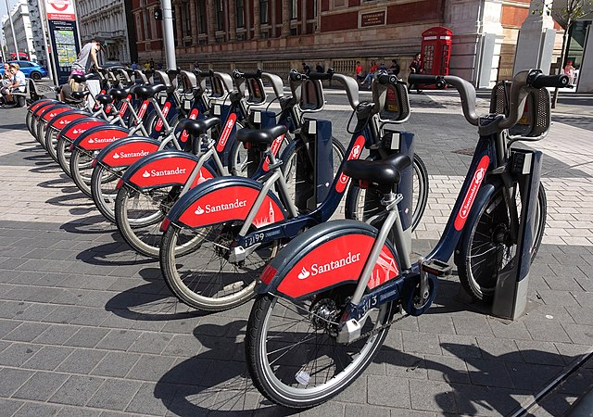
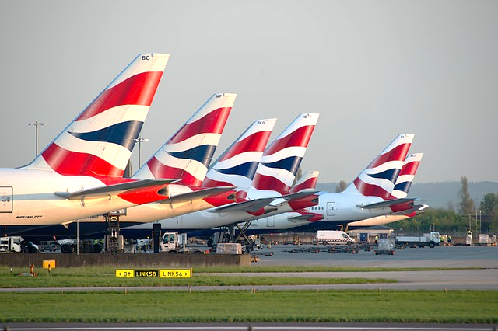
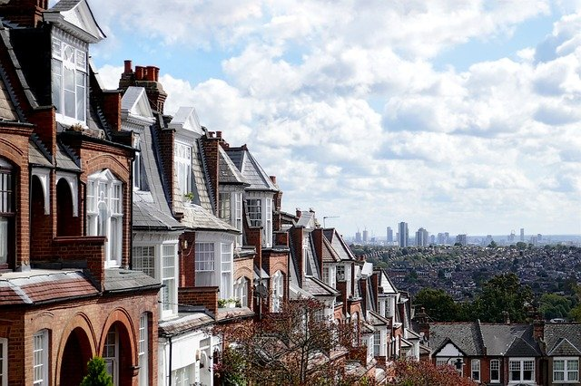
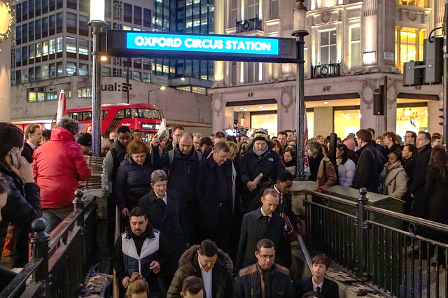
Take 10: London, a global city
What do these images represent?
Notes:
© Tiia Monto, Santander bicycles on the Exhibition Road in London, 2018, commons.wikimedia.org/w/index.php?curid=71800653

Slide 2
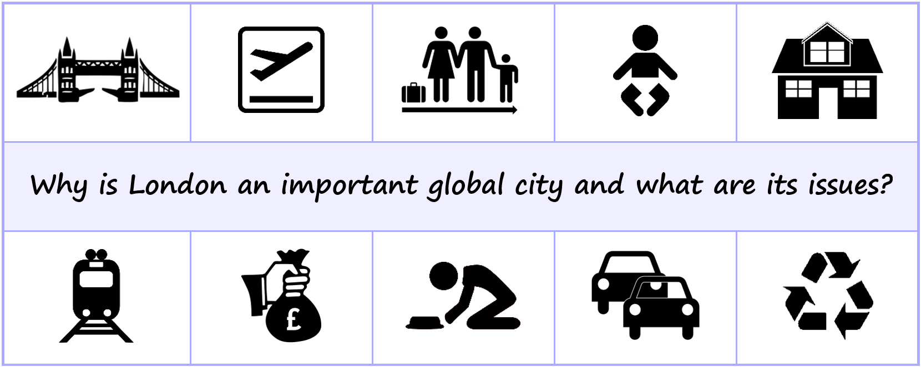
Take 10: London, a global city
Learning objective:
To revise and learn 10 facts about London and apply them to an exam-style question.
Key words for the lesson
Affluence
Deprivation
Baby boom
Globalised
Rural–urban migration
Sustainability

Slide 3
Take 10: London, a global city
London is a global city, and it is one of the most globalised and well-connected cities on Earth.
Gatwick, Heathrow and London City airports help London to be so well connected with the rest of the world.

Slide 4
Take 10: London, a global city
Rural-urban migration has played a key role in the growth of London.
Following WW2, there was a baby boom – rapidly increasing the population in London.

Slide 5
Take 10: London, a global city
The house prices are some of the most expensive in the UK.
Many people commute into London, rather than living there, as housing is so expensive.

Slide 6
Take 10: London, a global city
London is a city of contrasts, with some very affluent areas, such as Kensington and Chelsea.
There are also many areas of deprivation, including Tower Hamlets and Newham (the site of the Olympic stadium).

Slide 7
Take 10: London, a global city
Key issues in London include traffic, housing, waste disposal, poverty and rising crime levels.
Huge steps have been taken to improve the sustainability of London, e.g. the transport system and water fountains.

Slide 8
Revision tip
Connect one idea to the next to create a chain of knowledge.
London is one of the most globalised and well-connected cities on earth. What helps it to be connected?
The three airports: Gatwick, Heathrow and London City. What else brings people to London?
Rural–urban migration has been a key factor its growth. What else increased the population?
The baby boom following WW2. All these people need houses, which could be why the house prices are some of the most expensive in the UK.

Slide 9
Take 10: London, a global city
Use the revision notes and tips on your handout to annotate the revision strips and to test your recall of key information.
You can then choose from the practice exam-style questions and peer-assess your work using the mark schemes provided.

