Slide 1
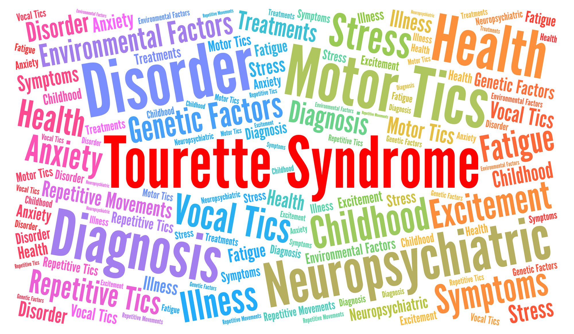
What is Tourette Syndrome?

Slide 2
2
Things people say to someone with Tourette Syndrome
Many people have a pre-conceived idea of what Tourette Syndrome (TS) is.
You may be surprised when you watch this video to learn the truth about the many different elements of TS.
Notes:
This video was made by Tourettes Action to help dispel any myths and squash any stigmas around this condition.
It was made in the style of the BBC series on ‘What not to say’.

Slide 3
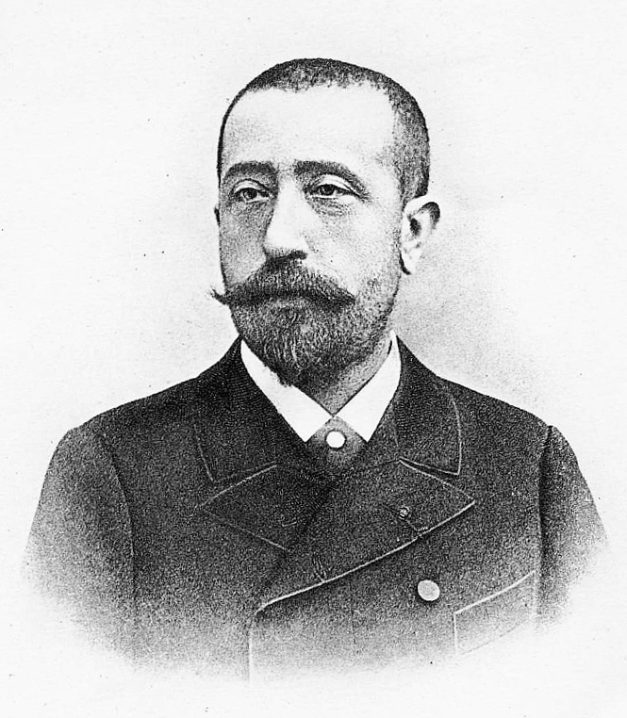
This is Gilles de la Tourette. He was a French Neurologist who first discovered this neurological condition that caused people to tic.

Slide 4
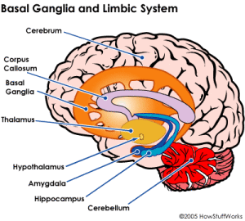
No one knows how TS is caused or how to prevent it, but research does point to differences in the Basal Ganglia at the base of the brain. Almost all cases of Tourette Syndrome result from a variety of genetic and environmental factors, and not changes in a single gene.

Slide 5
Everyone’s brain is unique and works in different ways

Slide 6
What is it?
Tourette Syndrome is a neurological condition.
People with Tourette Syndrome have involuntary tics.
Tics mean they may make sounds and do movements they really can’t control.
You can have tics at any age.

Slide 7
What are tics?
Muscle movements or noises which the person can’t help doing.
Tics can be fast.
They can happen again and again.
Tics can change.
People with Tourette Syndrome are not doing them on purpose.

Slide 8
Here are some examples of common motor and vocal tics:
8
 | Motor Tics | Vocal Tics
Simple | Eye blinking Eye rolling Grimacing (pulling faces) Shoulder shrugging Limb and head jerking/head nodding Abdominal tensing | Whistling Throat clearing Sniffing Coughing Tongue clicking Grunting Animal sounds
Complex | Jumping Twirling Touching objects and other people Obscene movements or gestures (copropraxia) Repeating other people’s gestures (echopraxia) | Non obscene socially inappropriate (NOSI) behaviour (e.g. remarking about a person’s weight or inappropriately touching someone) Involuntary swearing (coprolalia) Repeating a sound, word or phrase (echolalia)
Notes:
Here is a list of tics that you may have seen in pupils either with TS or undiagnosed.

Slide 9
9
Hidden Tics
Visual tics e.g. looking at shadows/counting objects
Intrusive thoughts e.g. harming someone or themselves
Suggestive tics e.g. overwhelming urges to follow through inappropriate suggestions
Thought tics e.g. something we all think but kids with TS can’t regulate. (It can be a bit like having a window into their soul)
Conversational/contextual e.g. these can sound and appear to be in the correct context but they just find it hard to switch off their regulator button
Notes:
Its really important to know that tics are not always just the obvious ones we can see or hear but there can be lots of hidden tics that children may be dealing with internally that you may not be aware of. These can often be the ones that are most uncomfortable for them.
Two of the most difficult to understand are the thought and conversational/contextual tics.
An example of a thought tics could be where a teacher walks in the room and they are bald or smelling of body odour. A neuro typical child may also notice those features but not say anything. A child with TS may find it hard to not vocalise this information as impulsivity can be extremely high so may result in the overwhelming urge to vocalise their thought into words.
An example of a conversational/contextual tic could be, for example, if when telling a child to concentrate, they utter the words ‘shut up’. If the teacher does not know the child well then this could appear like a genuine response and not a tic. However, please consider the fact that the child may just have an overwhelming urge to say the most inappropriate thing at this anxious time and may just come out with the very worse things they would be trying not to say.

Slide 10
The swearing tic
This is just another type of tic - the one everyone knows about!
It’s quite uncommon in children with TS.
In fact ... approximately only 10% of children with
TS have it.
The name for this type of tic is “coprolalia”
(cop – row – LA – lee – ya)
We must remember that a swearing tic has no intentional meaning. Speak to an adult if you are worried by this.

Slide 11
What it’s not
Tourette Syndrome is not a mental illness.
Tourette Syndrome does not affect how intelligent you are.
You can’t catch it - it’s not infectious.

Slide 12
Tics wax and wane
He didn’t do that last week ...
They come and go.
They change in how severe they are …
And how often they occur.
He’s doing it all the time now.
She’s just putting it on.
People with Tourette Syndrome are not doing their tics on purpose.

Slide 13
Other Symptoms
People with TS often have other symptoms alongside their tics that we can’t see.
One of the most common of these is worrying thoughts or the feeling that something terrible might happen. These can be very hard to explain and may need your understanding.

Slide 14
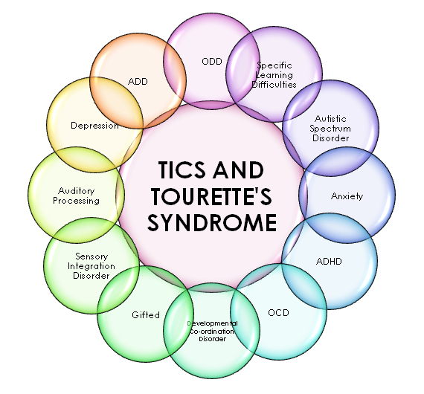

Slide 15
Some people with TS may be able to stop their tics for a short time if they concentrate really hard, but this can feel very uncomfortable.
This sometimes confuses teachers and other pupils.
Lets try it!
Try not to blink for a whole minute and you’ll see how uncomfortable this feels. This is how some children describe how it feels to hold in a tic.

Slide 16
Stop doing that! It’s driving me mad!
But I cant help it!
We must never ask a person with TS to stop ticcing.

Slide 17
Who has TS?
One in every hundred school children has TS
It occurs most commonly in boys
TS can often reduce and in some people even completely disappear by the age of 18
Did you know that singer Billie Eilish and famous YouTuber Caspar Lee both have TS?

Slide 18
What can make tics worse?
Worry, anxiety, stress, hunger, excitement, change, tiredness
What can make tics better?
Exercise, distraction, deep concentration, mindfulness, sleep, routine

Slide 19
How can you help someone with TS?
Learn as much about TS as you can.
Talk to them and ask them how you can help.
Be kind and understanding.
Don’t tease them about their tics.
Stand up for them if they are bullied.
Give them some time on their own if they want to release some tics in private.
Help them to join in - don’t leave them out.

Slide 20
20
Tourettes Action talks to Caspar Lee
Watch our video in conjunction with famous YouTuber Caspar Lee who also has TS. In this video he talks to a group of school children about their TS, how it feels and how people can help.

Slide 21
You are now a Tourette Syndrome expert!
You now know more about TS than most adults!
Why not test your family at home?

Slide 22
Thank you!

