Slide 1

Science Advent calendar
Click on the day you wish to uncover on the following
main calendar page.
Click when prompted to uncover facts, activities, links
and jokes.
When you have finished, click ‘back’ to
return to the main calendar page.
Click to begin!

Slide 2

6
7
3
17
21
12
25
20
15
9
18
1
16
13
4
5
23
24
10
11
22
2
8
14
19

Slide 3



1st December
(24 days to go)
What notable event happened on 1st December 1783?
H₂SO₄ + iron filings
= hydrogen
Click to reveal the answer
Go
back
Notes:
3

Slide 4



Answer
1st December 1783 was the first manned voyage of a hydrogen balloon. It left Paris and flew for 2 hours travelling a distance of 43 km.
Sulfuric acid and iron filings were used to generate the hydrogen.
Go
back

Slide 5
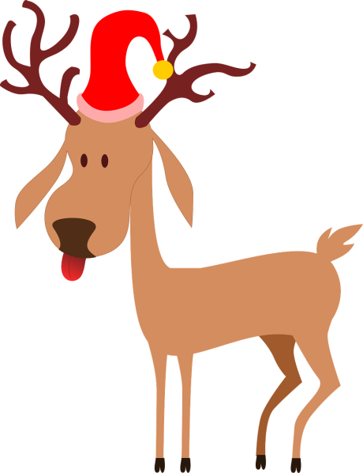
2nd December
(23 days to go)
Interesting Christmas fact …
Did you know that there are species of reindeer that have
red noses?
Scientists have found that it’s due to densely packed blood vessels in their noses – to help them control their body temperature.
Click for a short video.
Go
back

Slide 6

3rd December
(22 days to go)
Interesting Christmas fact …
On December 16th 1965, astronauts on-board
the Gemini 6 space rocket sang ‘Jingle
Bells’ back to Earth.
Sing-a-long to this science version of the 12 days
of Christmas.
Google more Christmas tunes with science lyrics or why not make up your own?
Try a Christmas puzzle
Go
back

Slide 7

Christmas puzzle!
Answer:
There are 78 gifts given on the 12th day.
Over the whole 12 days there are 364 gifts given, one for every day of the year.
Isn’t that nice?
In the famous song, the following gifts are given:
  1 partridge in a pear tree,
  2 Turtledoves,
  3 French hens,
  4 calling birds,
  5 gold rings,
  6 geese laying,
  7 swans a’swimming,
  8 maids a’milking,
  9 ladies dancing,
  10 lords a’leaping,
  11 pipers piping
  12 drummers drumming.
How many gifts were given over the 12 days? (Think about the words of the song!)
How many gifts were given on the 12th day of Christmas?
Click for the answer
Go
back

Slide 8
4th December
(21 days to go)
Christmas card puzzle …
Christmas joke!
Can you step completely through a Christmas card? Take a card or piece of A4 paper and a pair of scissors and have a go.
What’s brown, sugary and creeps around the Christmas dinner?
Click for the answer
Mince spies!
Click to reveal answer!
Go
back

Slide 9

5th December
(20 days to go)
Anyone for mince flies?
With a world population of over 7 billion
and rising, there are concerns about how to
feed everyone.
Insects are a nutritious source of
protein – how about trying locust
and mealworm mince pies?
www.youtube.com/watch?v=zdT0JyLdEwg
Go
back

Slide 10
6th December
(19 days to go)
Chemis-tree
Instead of a Christmas tree, try making a Chemis-tree for the science lab. You can use clamp stands and flasks, or decorate your tree with molecular models.
Christmas joke!
“Can you smell carrots?”
Click to reveal answer!
What did one snowman say to the other snowman?
Go
back

Slide 11
7th December
(18 days to go)
Christmas fact …
Christmas trees
Christmas trees need to cope with being cut and put inside for a few weeks.
What features should a Christmas tree have?
Find out more about the
science of Christmas trees.
When Prince Albert (Queen Victoria’s husband) began the British tradition of celebrating Christmas with a tree in 1850, he ordered that it be hung from the ceiling!
Go
back

Slide 12
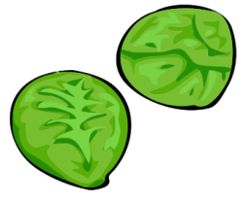
8th December
(17 days to go)
Gene TAS2R38
Sprout survey
Brussel sprouts - you either love them or hate them. Scientists have found that some people have the gene TAS2R38 which means that they can taste a
bitter chemical in
the sprouts.
Do a quick survey of the class to see who has tried
Brussel sprouts
and how many people like/dislike eating them.
Click to find out more
Go
back

Slide 13
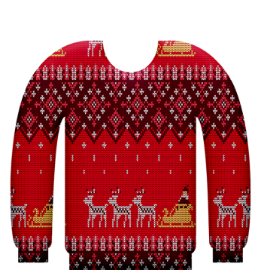
9th December
(16 days to go)
Interesting
Christmas fact …
Christmas jumpers
The more glittery and sparkly, the better.
Can you design a Christmas jumper that incorporates wearable technology?
Click here for some ideas from the Royal Institution.
Christmas jumpers have seen a huge increase in popularity in recent years.
Around 12 million Christmas jumpers are sold annually in the UK.
Go
back

Slide 14

10th December
(15 days to go)
Interesting
Christmas fact …
The science of snowflakes ...
Watch the videos to find out if snowflakes really are all different:
www.youtube.com/watch?v=fUot7XSX8uAk
www.periodicvideos.com/videos/feature_snow.htm
According to the weather forecasters, it’s only a White Christmas if a snow flake falls on the roof of Met Office in London. That only happened three times in the last century!
Did you know you can make fake snow using the gel like filling found in nappies?
www.periodicvideos.com/videos/fake_snow.htm
Go
back

Slide 15
11th December
(14 days to go)
Christmas lights …
People have traditionally used light to cheer up dark wintry days and nights. Fairy lights and illuminated Christmas trees are very popular today. Can you match the innovation in Christmas lighting with the date?
A. Candle holders generally used.
1184
18th century
1882
1890s
1930
2000
B. Energy saving LEDs used.
C. Candles glued to tree with melted wax.
D. First electrically illuminated Christmas tree.
E. First recorded burning of a yule log in Germany.
F. Christmas tree lights replace candles in homes.
Click for the answer
Go
back

Slide 16
Answers
E. First recorded burning of a yule log in Germany.
1184
18th century
1882
1890s
1930
2000
C. Candles glued to tree with melted wax.
D. First electrically illuminated Christmas tree.
A. Candle holders generally used.
F. Christmas tree lights replace candles in homes.
B. Energy saving LEDs used.
Go
back

Slide 17

12th December
(13 days to go)
Elementary Christmas …
SnOW & Ice
SeAsONAl CHeEr
Ho Ho Ho
Can you think of any more?
Go
back

Slide 18

13th December
(12 days to go)
Mistletoe …
Watch this video from the Natural History Museum to find out more...
Mistletoe is a hemi-parasite.
What do you think this means?
Go
back

Slide 19

14th December
(11 days to go)
The maths of Santa
Mathematicians have worked out that to deliver presents to all the world’s children, Santa has to travel at 650 miles per second and visit 822 homes every second of Christmas Eve!
The science of Santa
Does Santa need to break
the laws of physics to deliver all the presents?
Find out more when Santa wrote to Professor Brian Cox.
Go
back

Slide 20

15th December
(10 days to go)
Interesting Christmas facts …
According to the Guinness world records, the tallest Christmas tree ever cut was over 220 foot. It was put on display in Seattle in America in 1950.
If it takes 6 years to grow a 10 foot tree, which year would it have been planted?
Click to reveal answer!
1818
Go
back

Slide 21


16th December
(9 days to go)
Throw away
Christmas …
In Britain in 2010, we threw away
227 000 miles of wrapping paper and 125 000 tonnes of plastic wrapping. It’s difficult to recycle a lot of the paper e.g. metallic foil.
In Japan they reuse cloth to wrap presents, called Furoshiki. Share your ideas for recyclable wrapping and see how they do it in Japan.
Go
back

Slide 22
17th December
(8 days to go)
Christmas challenge …
Christmas riddle
You have 2 minutes to make a list of all the ways we could save energy and resources at Christmas.
Look at some ideas from the Energy
Saving Trust.
Which letter does the alphabet lose during Christmas?
There’s no-L
time during
Christmas …
Click to reveal answer!
Go
back

Slide 23

18th December
(7 days to go)
Secret Santa…
If you could buy a ‘Secret Santa’ present for any famous scientist, past or present, who would you choose, what would you buy, and why?
Go
back

Slide 24
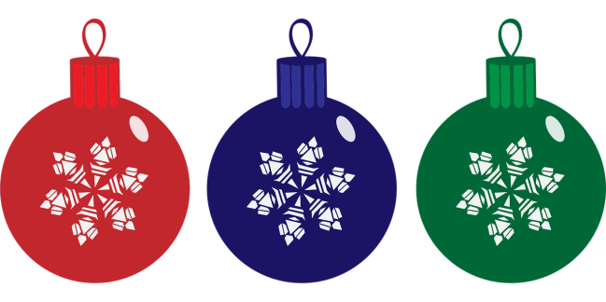

19th December
(6 days to go)
Christmas party tricks…
Flying tinsel?
Impress friends and family on the big day by watching some of these try-it-at-home Christmas experiments from STEM Learning.
Share any of your fun family traditions with others.
Go
back

Slide 25

20th December
(5 days to go)
Elementary Christmas …
Can you crack the element code for some seasonal words and phrases?
Phosphorus, Radium, Nitrogen, Carbon, Erbium
Iodine, Carbon, Iodine, Chlorine, Einsteinium
Holium, Holium, Holium
Click for the answer
Go
back

Slide 26
Answers
Phosphorus, Radium, Nitrogen, Carbon, Erbium = PRaNCEr (a reindeer)
Iodine, Carbon, Iodine, Chlorine, Einsteinium
= ICICleS
Holium, Holium, Holium = Ho, Ho, Ho
Go
back

Slide 27

21st December
(4 days to go)
Jumping flames and jelly …
Merry Christmas!
Have a happy Christmas and a marvellous New Year from all of your teachers!
Ho! Ho! Ho!
If you want do to some science at the dinner table, here are some Christmas party tricks to try!
Go
back
And finally...
click here

Slide 28
Eh? What are you doing here?
Did you get locked in?
The bad news is that you’ll be stuck here until after Christmas.
The good news is that there’s a sack of sprouts left over in the kitchen. Yum.
Go
back

