Slide 1
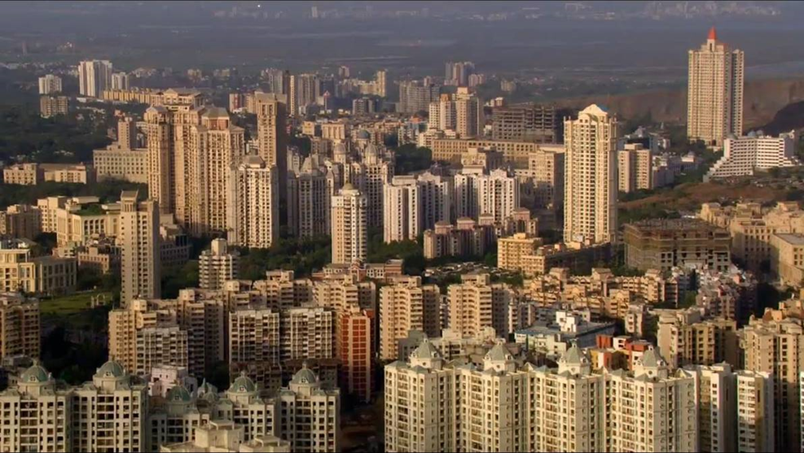
Where am I?
It started life as a series of fishing villages on seven islands but now is a major world city.
Notes:
Kindly shared by Deepak Gupta, available at: flic.kr/p/6u8RFS

Slide 2
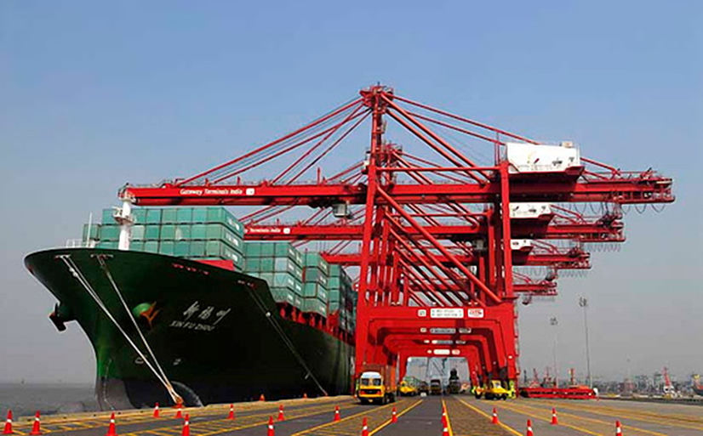
Where am I?
It is now a major port.
Jawaharlal Nehru Trust Port
Notes:
Image used courtesy of Jaxer at English Wikipedia under the Creative Commons Attribution 3.0 Unported license, 2008. en.wikipedia.org/wiki/File:Jawaharlal_Nehru_Trust_Port.jpg

Slide 3
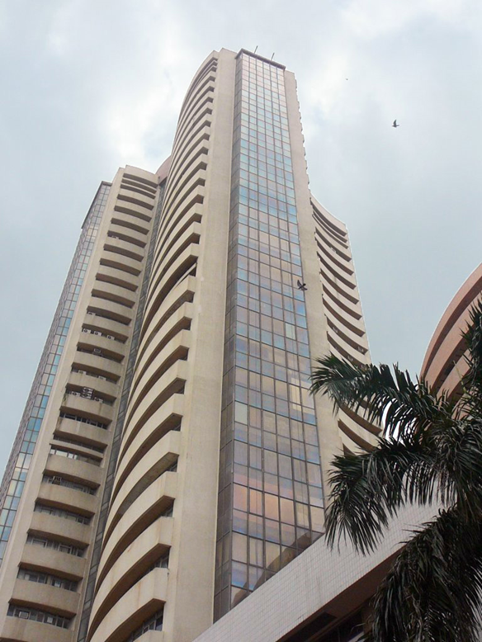
Where am I?
It is one of the world’s important financial centres.
Notes:
Kindly shared by Appaiah, available at: flic.kr/p/2M1cWX

Slide 4
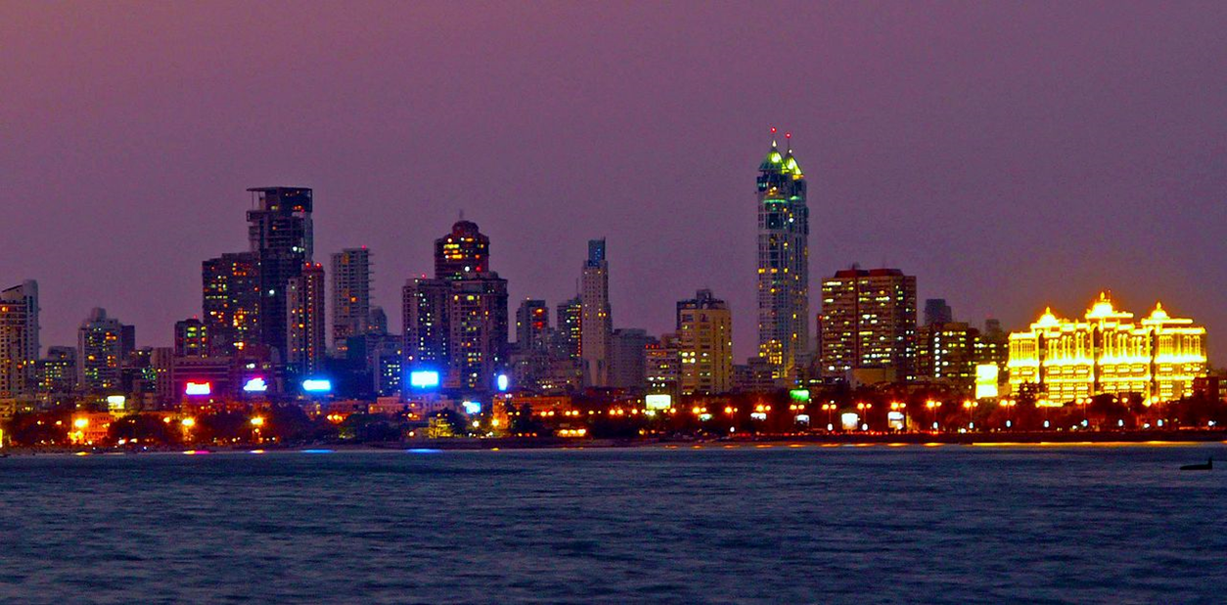
Where am I?
It is also the country’s commercial capital.
Notes:
Image used courtesy of Cidity Hat, at English Wikipedia under the Creative Commons Attribution 3.0 Unported license, 2011. Available at: commons.wikimedia.org/wiki/File:Mumbai_Skyline_at_Night.jpg

Slide 5
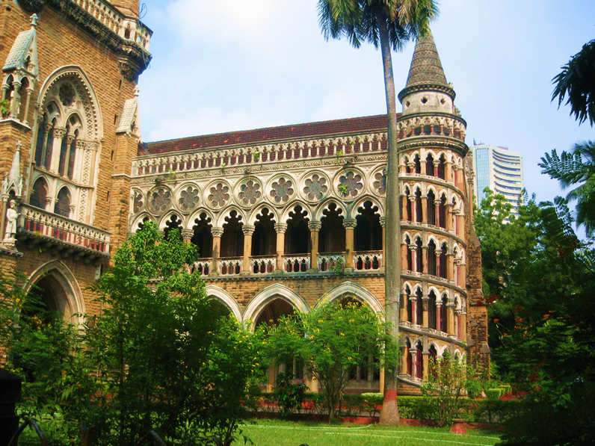
Where am I?
It is a major centre of learning and education. There is a world renowned university and many other important education and research institutions.
Notes:
Kindly shared by Stefan, 2008, available at: flic.kr/p/5CdpCF

Slide 6
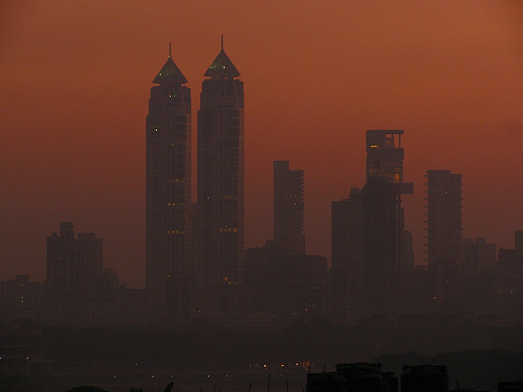
Where am I?
There are some areas of very high wealth. It has some of the most expensive property in the world, e.g. one single 28 storey building is worth £2 billion.
Notes:
Kindly shared by Satish Krishnamurthy. Available at: flic.kr/p/94ZSYm

Slide 7
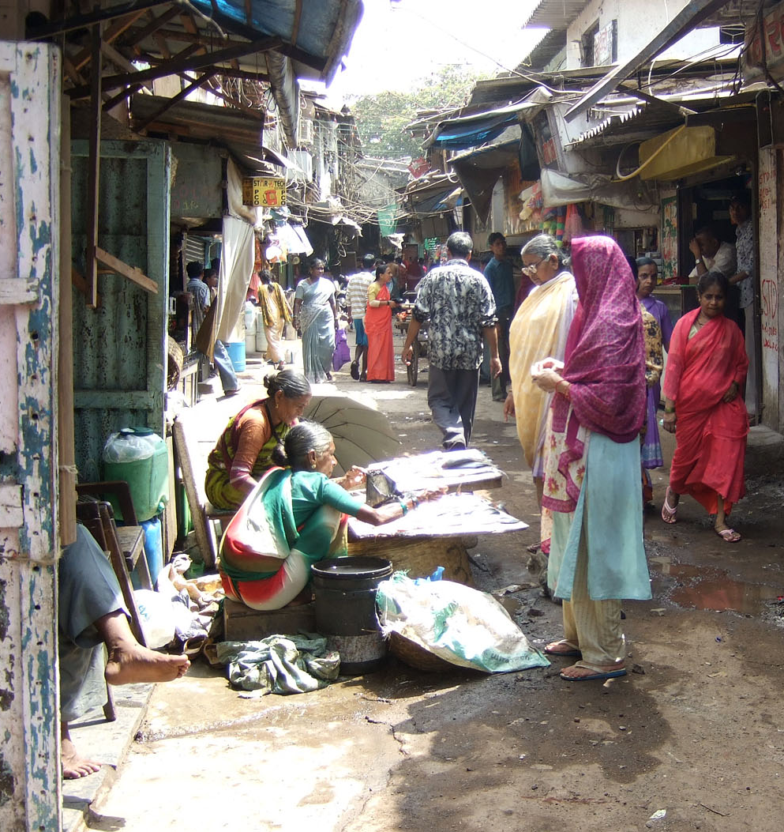
Where am I?
Today, around 9 million or 62% of the population live in squatter settlements, referred to as bustees. It has the second largest slum in Asia; Dharavi is home to between 800 000 to 1 million people, all within just 2.39 km².
Notes:
Image used courtesy of Kounosu, under the Creative Commons Attribution-Share Alike 3.0 Unported, license, 2008. commons.wikimedia.org/wiki/File:Dharavi_Slum_in_Mumbai.jpg

Slide 8
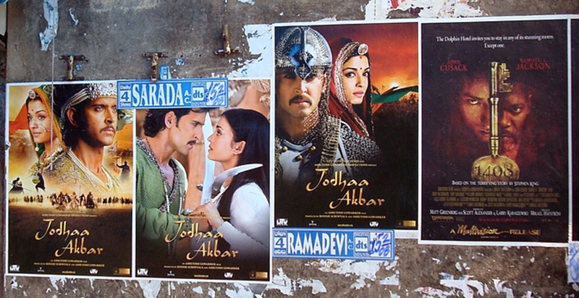
Where am I?
It is a centre of culture, e.g. for Bollywood films. Bollywood is also one of the biggest film industries in the world. In 2011, over 3.5 billion tickets were sold across the globe – more than Hollywood!
Notes:
Free for commercial use, no attribution required. pixabay.com/photo-995224/

Slide 9
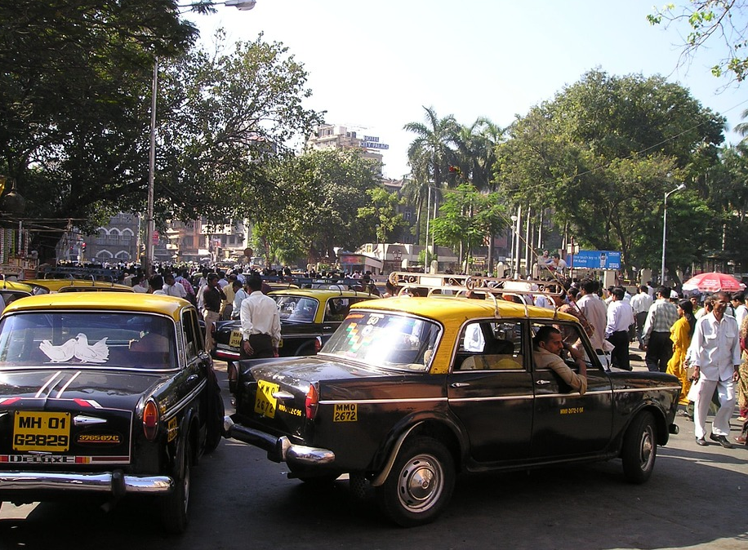
Where am I?
It is a megacity. It is India’s largest city with a population in excess of 21 million in 2015.
Notes:
Free for commercial use, no attribution required. pixabay.com/photo-286/

Slide 10
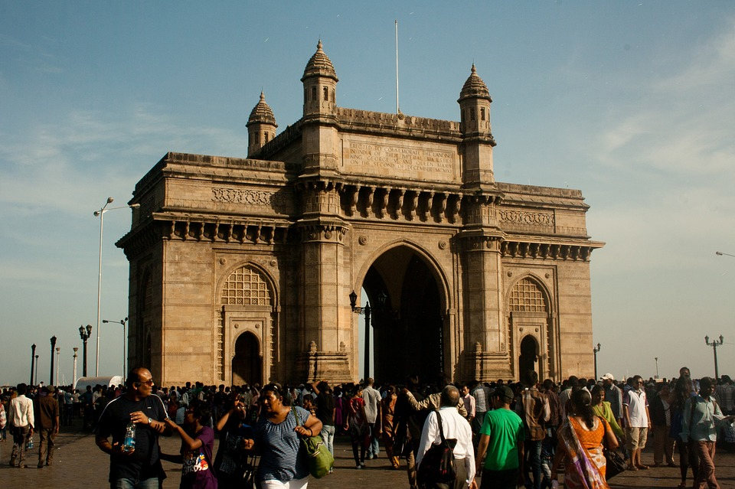
Where am I?
It was formerly known as Bombay.
Gateway of India, Bombay
Notes:
Free for commercial use, no attribution required. pixabay.com/photo-390769

Slide 11
Where am I?
I am in Mumbai, मुंबई, Bombay
Mumbai previously known as Bombay, on the west coast of India, is the most populous city in India and the ninth most populous agglomeration in the world, with an estimated population in excess of 21 million in 2015.
Notes:
Kindly shared by Deepak Gupta, available at: flic.kr/p/6u8RFS

Slide 12
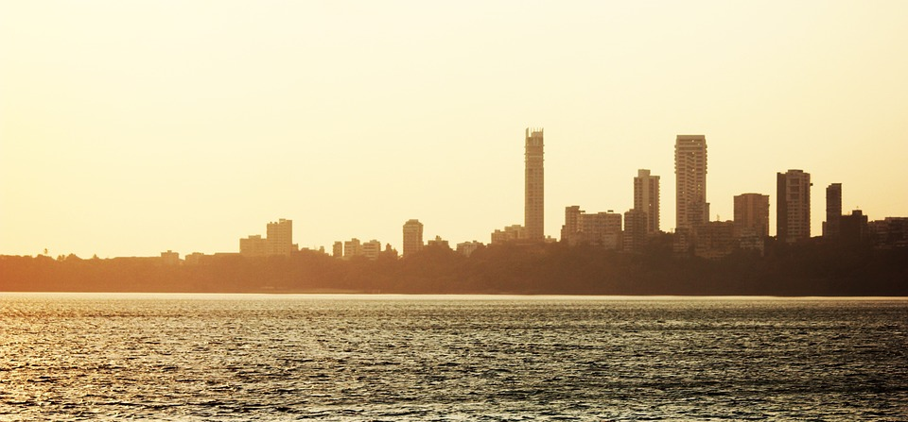
Where am I?
I am in Mumbai, मुंबई, Bombay
The city is the wealthiest city in India, and has the highest GDP of any city in South, West, or Central Asia. Mumbai has the highest number of billionaires and millionaires among all cities in India.
Notes:
Free for commercial use, no attribution required. pixabay.com/photo-390483/

