Slide 1
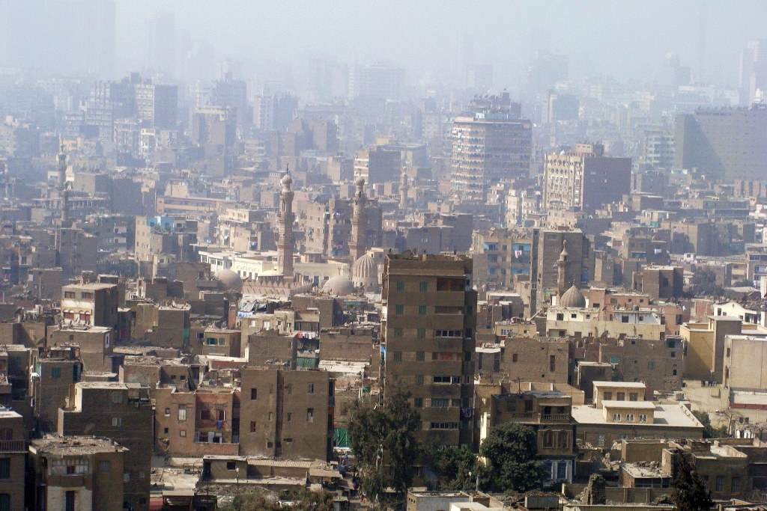
Notes:
Cairo in Smog, Silar, commons.wikimedia.org/wiki/File:0021_Cairo_in_smog,_2010.JPG, 2010, CC BY-SA 3.0

