Slide 1
Urban sustainability
The GCSE Geography syllabus says you should know that:
urban sustainability requires management of resources and transport.
Are you …
100% confident?
I am okay with this, some work needed?
Definitely need more revision?

Slide 2
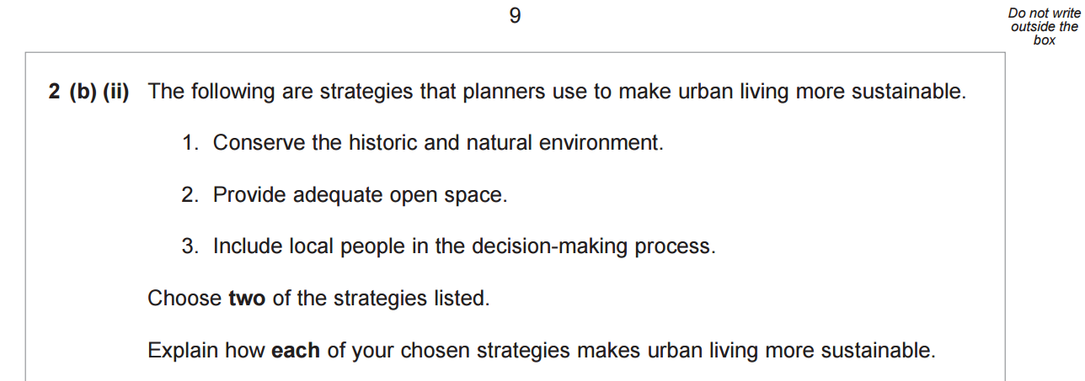
Examination question
Notes:
AQA GCSE Geography 2013 filestore.aqa.org.uk/subjects/AQA-40302H-QP-JUN13.PDF

Slide 3
Strategy 1
Conserving the historic and natural environment makes urban living more sustainable.
Explain how this strategy makes urban living more sustainable.

Slide 4
Strategy 1
Conserving the historic and natural environment makes urban living more sustainable.
Once buildings etc. are knocked down they are gone for ever.
We are protecting and conserving the historic and natural environment for future generations.
If these resources are used up by people today, they will not be available for future generations to use.

Slide 5
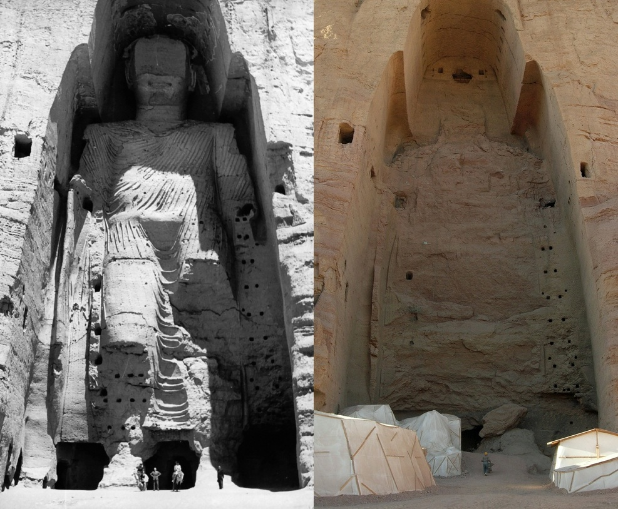
Strategy 1 example
Once buildings etc. are knocked down they are gone forever.
The large Buddha statue at Bamiyan, Afghanistan was hewn from the sandstone cliff in 554 AD. It was dynamited and destroyed in 2001 after the Taliban government declared it was an idol.
Notes:
Buddha of Bamiyan 2009, Buddha_Bamiyan_1963, UNESCO/A Lezine, Carl Montgomery. commons.wikimedia.org/w/index.php?curid=8249891, CC BY-SA 3.0

Slide 6
Strategy 2
Providing adequate open space makes urban living more sustainable.
Explain how this strategy makes urban living more sustainable.

Slide 7
Strategy 2
Providing adequate open space makes urban living more sustainable.
Existing areas, like parks, need to be left alone because they are important for people’s social well-being.
If they are built on, they will be difficult to restore for the future.
The loss of parks make have an impact on people’s health, e.g. less outdoor sport

Slide 8
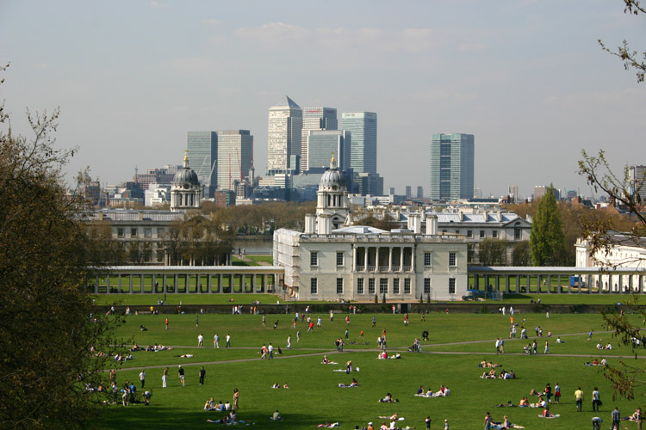
Strategy 2 example
Existing areas, like parks, need to left alone because they are important for people’s social well-being.
Greenwich Park, one of the green lungs of London with view over Canary Wharf.
Notes:
Image used courtesy of WikiWitch, en.wikipedia.org/wiki/File:Greenwich_Park_Canary_Wharf.jpg, 2007, CC BY-SA 3.0

Slide 9
Strategy 3
Including local people in the decisions-making process makes urban living more sustainable.
Explain how this strategy makes urban living more sustainable.

Slide 10
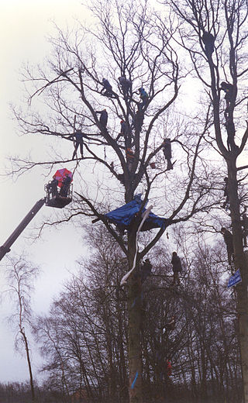
Strategy 3 example
People are much more likely to support ideas if they feel part of a community and, therefore, the ideas are more likely to be successful into the future
Protestors being removed after trying to stop the construction of a bypass.
Notes:
Image used courtesy of Nick Wooley, en.wikipedia.org/wiki/File:Tot_Hill_eviction.jpg, 1996, CC BY-SA 2.5

Slide 11
AQA mark scheme
Notes:
filestore.aqa.org.uk/subjects/AQA-40302H-W-MS-JUN13.PDF

