Slide 1
Circuits, current, resistance and potential difference
Current and potential difference in series and parallel circuits
Ohm’s Law, V = I R

Slide 2
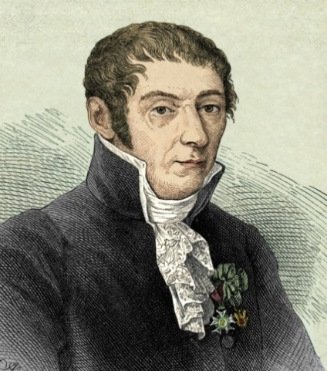
Basic ideas
amps
Electric current is when electrons start to flow around a circuit. We use an to measure it and it is measured in .
ammeter
amperes
voltage
Potential difference (also called ______) is how big the push on the electrons is. We use a ________ to measure it and it is measured in ____, a unit named after Alessandro Volta.
voltmeter
volts
Resistance is anything that resists an electric current. It is measured in _____.
ohms
Keywords: volts amps ohms potential difference ammeter voltmeter
Notes:
Alessandro Volta, Italian physicist / Credit: Sheila Terry / Science Photo Library / Universal Images Group / Copyright © Sheila Terry / For Education Use Only. This and millions of other educational images are available through Britannica Image Quest. For a free trial, please visit www.britannica.co.uk/trial

Slide 3


More basic ideas
increase
If a battery is added, the current will ________ because there is a greater _____ on the electrons.
‘push’
decrease
If a bulb is added, the current will because there is greater in the circuit.
resistance

Slide 4
Current in a series circuit
If the current here is 2 amps, …
the current here will
be …
2 amps
the current here will
be …
and the current here will be …
2 amps
2 amps
In other words, the current in a series circuit is the same at any point.

Slide 5
Current in a parallel circuit
A parallel circuit is one where the current has a ‘choice of routes’.
Here comes the current …
Half of the current will go down here (assuming the bulbs are the same) …
and the rest will go down here …

Slide 6
Current in a parallel circuit
If the current here is 6 amps,
...
and the current here will be …
the current here will be …
6 amps
2 amps
the current here will be …
the current here will be …
2 amps
2 amps

Slide 7
Potential difference in a series circuit
If the potential difference across the battery is 6V, …
V
… and these bulbs are all identical …
… what will the potential difference across each bulb be?
V
V
2V
2V
2V
V

Slide 8
Potential difference in a series circuit
If the potential difference across the battery is 6V, …
V
… what will the potential difference across two bulbs be?
V
4V

Slide 9
Potential difference in a parallel circuit
If the potential difference across the batteries is 4V, …
... what is the potential difference here?
4V
V
... and here?
4V
V

Slide 10

Summary
In a series circuit:
Current is the same at any point.
Potential difference is shared between each component.
In a parallel circuit:
The total current is split between each branch.
Potential difference is the same across each branch.

Slide 11
Summary (continued)
In a parallel circuit:
The current will always be higher on branches with
lower resistance.
The potential difference is shared equally between components on any one branch as these are essentially in series to each other.

Slide 12
What are the readings in this circuit?
6V
A4
A₃
A₁
4 A
4 A
2 A
V₁
Assume that the total resistance of the bulbs in each branch of the parallel circuit is the same.
6 V
2 A
A₂
A₂
3V
VV
V₂
3V
V3
V₂

Slide 13


Advantages of parallel circuits
There are two main reasons why parallel circuits are used more commonly than series circuits:
Extra appliances (like bulbs) can be added without
affecting the output of the others.
If one appliance breaks, it won’t affect the others either.

Slide 14
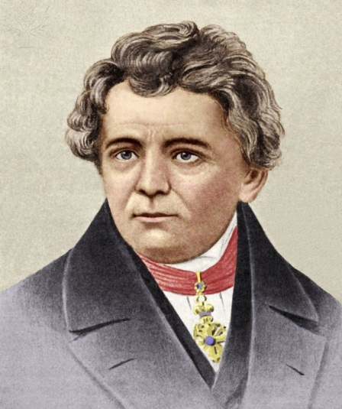
Resistance
Resistance is anything that will resist a current. It is measured in ohms, a unit named after me.
The resistance of a component can be calculated using Ohm’s Law:
Georg Simon Ohm 1789-1854
resistance (in Ω) = potential difference (in V)
current (in A)
V
I = current
V = potential difference
R = resistance
I
R
Notes:
Georg Simon Ohm, German physicist / Credit: Sheila Terry / Science Photo Library / Universal Images Group / Copyright © Sheila Terry / For Education Use Only. This and millions of other educational images are available through Britannica Image Quest. For a free trial, please visit www.britannica.co.uk/trial

Slide 15
What is the resistance?
Ammeter reads 2A
A
What is the resistance across this bulb?
Assuming all the bulbs are the same, what is the total resistance in this circuit?
V
5 Ω
Voltmeter reads 10V
15 Ω

Slide 16
Resistance – more examples
3A
2 Ω
1A
6V
2V
2 Ω
3A
2A
4V
What is the resistance of these bulbs?
2V
1Ω
2A
Notes:
Assume that the total resistance of the bulbs in each branch of a parallel circuit is the same.

