Slide 1
Use angular measures in degrees
Mathematics for GCSE Science

Slide 2
LO: Use angular measures in degrees
Angles are usually measured in degrees.
There are 360° in a whole turn.

Slide 3
Angles
A right angle is exactly 90° and is shown by a small square
An acute angle is less than 90°
An obtuse angle is between 90° and 180°
A reflex angle is between 180° and 360°
Right angle
Acute angle
Obtuse angle
Reflex angle

Slide 4
Right angles
Right angles measure 90°
This means that all angles inside a right angle must add up to 90°
65°
25°
65° + 25° = 90°

Slide 5
Right angles
Work out the size of angle 𝒙
We know that the sum of all angles inside a right angle is 90°
𝒙 + 65° = 90°
𝒙
65°
𝒙 = 90° - 65°
𝒙 = 25°

Slide 6
Angles around a point
Angles around a point add up to 360°
45°
120°
100°
95°
45 + 120 + 95 + 100 = 360°
This fact can be used to calculate missing angles.

Slide 7
Angles around a point
What is the size of angle 𝒙?
We know that the angles around a point add up to 360°
𝒙
The reflex angle is 320°
Therefore:
𝒙 + 320° = 360°
𝒙 = 360° - 320°
320°
360° - 320° = 40°
Angle 𝒙 measures 40°

Slide 8
Angles on a line
Angles on a straight line add up to 180°. This fact can also be used to calculate angles.
50°
80°
50°
80 + 50 + 50 = 180°

Slide 9
Angles on a straight line
What is the size of angle 𝒙?
We know that the angles on a straight line add up to 180°
The obtuse angle measures 130°
Therefore
𝒙 + 130° = 180°
𝒙 = 180° - 130°
180° - 130° = 50°
130°
𝒙
Angle 𝒙 measures 50°

Slide 10
Vertically opposite angles
Vertically opposite angles are equal
15°
165 °
165 °
15°

Slide 11
Vertically opposite angles
What are the sizes of angles 𝜶, 𝒃 and 𝒄?
80°
We know that the angles around a point add up to 360°
Therefore
𝜶 + 𝒃 + 𝒄 + 80° = 360°
We know that opposite angles are equal.
𝜶
Therefore
𝜶 = 𝒄
𝒃 = 80°
𝒄
𝒃 + 80° = 80° + 80°
=160°
360 ° - 160° = 200°
200° ÷ 2 = 100 °
𝒃
𝜶 = 100° 𝒃 = 80° 𝒄 = 100°

Slide 12
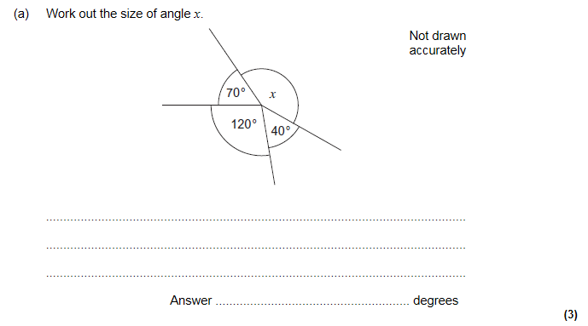
Some questions to try from
GCSE Maths F

Slide 13
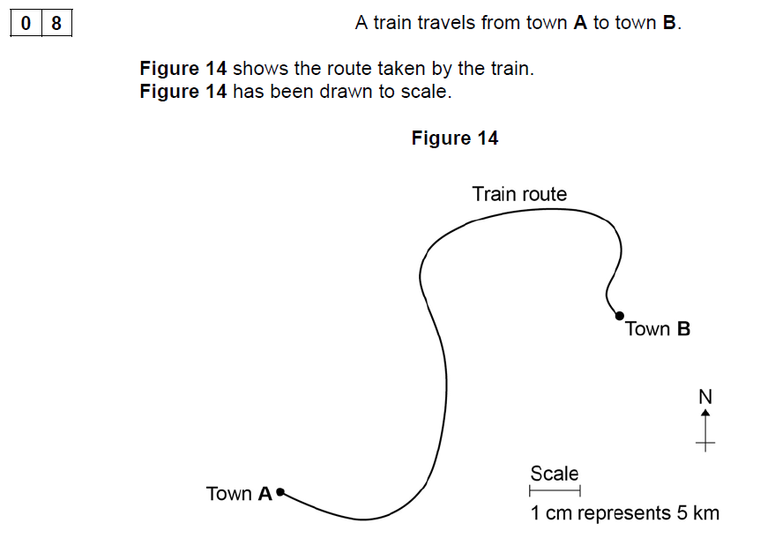
GCSE Physics sample assessment materials

