Slide 1
Christmas advent calendar
Tutor time
Click on a date to reveal a festive tutor time idea, activity or game.
When you have finished, click ‘back’ to return to the date page.

Slide 2
5
22
21
9
6
18
2
15
8
17
16
1
4
10
7
11
20
19
12
23
14
13
24
3

Slide 3
1st December
(24 days to go)
Fake news?
Read the following facts about Christmas. Which facts are true and which are lies?
It is officially illegal to eat mince pies on Christmas day, since Oliver Cromwell banned Christmas in 1647.
False
Rudolph was originally going to be called Reginald in the song.
True
In Japan, it is traditional to eat Kentucky Fried Chicken on Christmas day.
True
Go
back
Make your own list of Christmas truths and lies.
Can you convince others of your fake facts?

Slide 4
2nd December
(23 days to go)
Interesting Christmas fact
Random act of Christmas kindness
Happy holiday hazards!
In the US, nearly 15,000 Americans visit the hospital during November and December due to holiday-related decorating accidents.
Christmas tree fires cause up to 17 deaths annually, and nearly $13 million in damage to homes.
Who would you reward with a random act of kindness this Christmas?
It could be a friend, family member or a public figure.
What would you do/buy
for them to say thanks,
and why?
Go
back

Slide 5
3rd December
(22 days to go)
Vote for the cheesiest Christmas song/video, or suggest your own!
Contenders …
Wham: Last Christmas
Madonna: Santa Baby
Mariah Carey: All I want for Christmas
Go
back

Slide 6
4th December
(21 days to go)
Top five of
the year
Christmas joke
What does Santa suffer from when he gets stuck in a chimney?
Best films?
Best school events?
Best songs?
Best news stories?
Claustrophobia!
Click for punchline!
Go
back

Slide 7
5th December
(20 days to go)
364 gifts
Using ‘The Twelve Days of Christmas’ song as your starting point, change some or all of the ‘gifts’ mentioned each day to make your own modern version of the song.
What gifts have you included and why?
(There should be 364 gifts in total, based
on the original song!)
Go
back

Slide 8
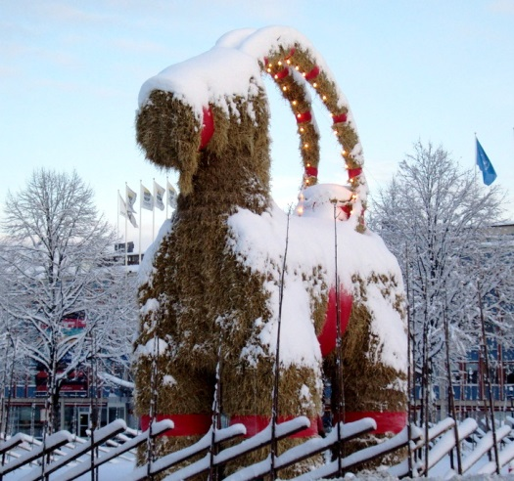
6th December
(19 days to go)
Christmas around the world
Working in pairs or small groups, share what you know about different Christmas traditions from other parts of the world.
If you are stuck for ideas,
you might want to find out
about El Caganer in Spain,
Sweden’s giant yule
goat or Iceland’s 13 Santas.
Go
back
Notes:
© Tony Nordin, 2009, commons.wikimedia.org/wiki/File:Yule_goat_Gefle_Sweden_2009_crop.jpg

Slide 9
7th December
(18 days to go)
Best ever …
Christmas joke
Share your Christmassy recommendations:
Best Christmas film?
Best Christmas book?
Best place to go?
Best thing to do?
Best food to eat?
What is Father Christmas’ favourite pizza?
One that’s deep-pan, crisp and even.
Click for punchline!
Go
back

Slide 10
8th December
(17 days to go)
Christmas cheers
In your opinion, who has changed the world for the better this year?
Who should we be toasting on Christmas day – and why?
Share your ideas in small groups, and be prepared to share with the whole tutor group.
Odd Christmas fact
In Germany and Poland, finding a spider’s web on a Christmas tree is believed to be good luck.
Go
back

Slide 11
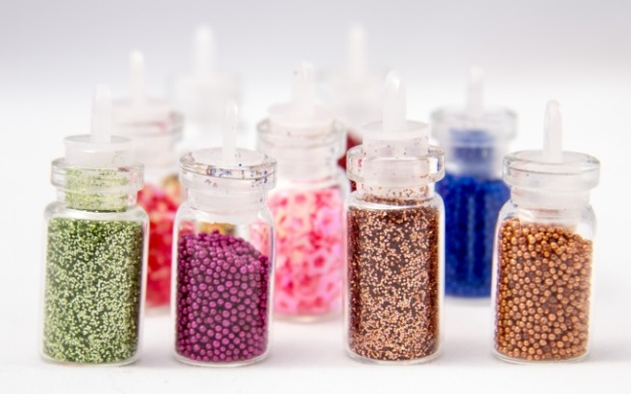
9th December
(16 days to go)
Christmas party tricks
Flying tinsel and jumping flames?
Impress friends and family on the big day by watching some of these try-it-at-home Christmas experiments from STEM Learning.
Share any of your fun
family traditions
with others.
Go
back

Slide 12
10th December
(15 days to go)
Fill in the gaps
You will be given a copy of a popular Christmas song with some of the words missing.
In pairs or small groups, fill in as many words as you can in two minutes.
The winners are the team to guess the most correct words.
Go
back
Try this Metro song quiz to get you started!

Slide 13
11th December
(14 days to go)
Room 101
pet hates
Christmas joke
What things about Christmas do you really dislike?
What would you change and why?
Discuss your ideas in pairs.
Who delivers presents to baby sharks at Christmas?
Santa Jaws
Click for punchline!
Go
back

Slide 14
12th December
(13 days to go)
Christmas quiz
In teams, write 10 Christmas-themed questions for a quiz (and keep a note of the answers!)
Each team will take it in turns to read out their questions.
Write down your team’s answers to the other question rounds.
The team with the highest score overall wins!
Go
back

Slide 15
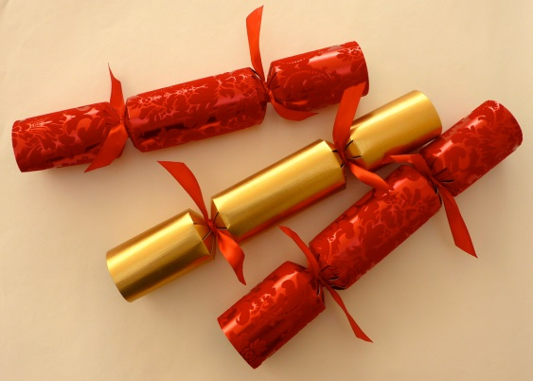
13th December
(12 days to go)
Best Christmas cracker joke competition
Write your own Christmas cracker joke.
Pass your joke around and
vote to choose your
tutor group’s favourite.
Stick the jokes on the
wall for others to enjoy!
Go
back

Slide 16
14th December
(11 days to go)
Christmas mash-ups
Butter-beer. Pizza fries. Marmite chocolate.
Food mash-ups are a new trend – can you think of any perfect Christmas food mash-ups?
Christmas dinner pot noodle? Sprout and apple juice? Share your ideas in groups.
Horrible history food mash-ups
Go
back
Before the turkey became popular for Christmas lunch in Britain, most people ate pig’s head and mustard. Yum!

Slide 17
15th December
(10 days to go)
Un-Christmas
Many people in the UK don’t celebrate Christmas, for religious, ethical or cultural reasons, or because they are alone.
Imagine a world without Christmas. What would a perfect un-Christmas day be?
Fun Christmas fact
The Finnish post office employs elves to work full-time sorting 550,000 letters which arrive each year. In recent years the number of letters has fallen from 600,000 and no one knows why.
Go
back

Slide 18
16th December
(9 days to go)
Christmas ‘what’s the question?’
If this is the answer, what’s the question?
10 million
Question: How many turkeys are eaten in the UK each Christmas?
113 feet
Question: How tall was the biggest snowman ever built?
1647
Question: When did Oliver Cromwell ban Christmas as immoral?
600,000
Question: How many letters will be sent to Father Christmas each year?
Go
back
Can you find any other Christmas facts to create your own ‘answers’ to challenge other students?

Slide 19
17th December
(8 days to go)
Alternative Christmas presents
Share ideas for alternative Christmas presents that you can make or do for others.
Put your ideas on sticky notes, and stick them
on your classroom wall in the shape of a
Christmas tree, or decorate as ‘presents’
for a seasonal display.
Go
back

Slide 20
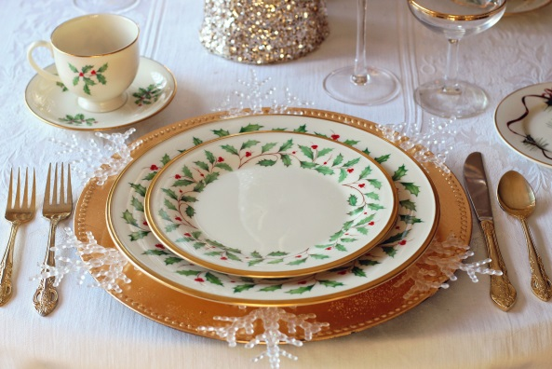
18th December
(7 days to go)
Fantasy Christmas meal
Create your dream menu (including both food and drink) for a Christmas meal with a twist.
Who would you invite, from the past or
present, to share your meal?
Go
back

Slide 21
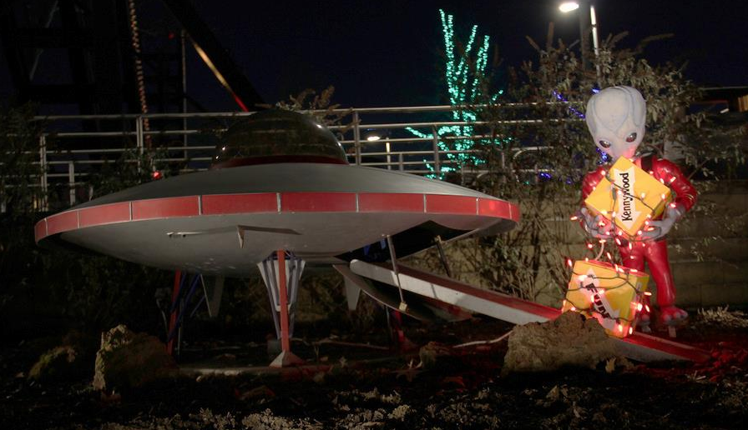
19th December
(6 days to go)
Christmas for aliens
If you had to explain Christmas to aliens, what three objects would you choose to explain what it is, and why?
Go
back
Notes:
© daveynin, 2011, www.flickr.com/photos/daveynin/6496915265/

Slide 22
20th December
(5 days to go)
Christmas odditorium
Think of some of the strangest festive traditions you’ve heard about.
What would you put in a Christmas odditorium (a museum celebrating the unusual aspects of the season)?
Here are some odd Christmas traditions to get you started:
In Spain you’ll find caga tió on your table, a pooing Christmas log which you feed daily with sweet treats
In Norway, you must hide your broom on Christmas Eve.
In Greenland, you’ll
eat mattak, or raw
whale blubber.
Go
back

Slide 23
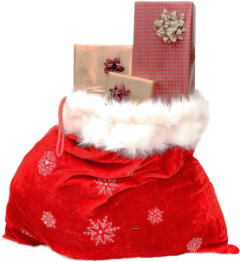
21st December
(4 days to go)
Secret Santa
If you could buy a ‘Secret Santa’ present for any famous person, past or present, or any character from a book or film, who would you choose, what would you buy, and why?
Share your ideas with others.
Go
back

Slide 24
22nd December
(4 days to go)
Dragon’s den
Think of an idea for a perfect Christmas invention, gift or unusual festive event.
In groups, share your ideas, choose your favourite and prepare for a Dragon’s den style presentation, selling us your
festive idea.
Go
back

Slide 25
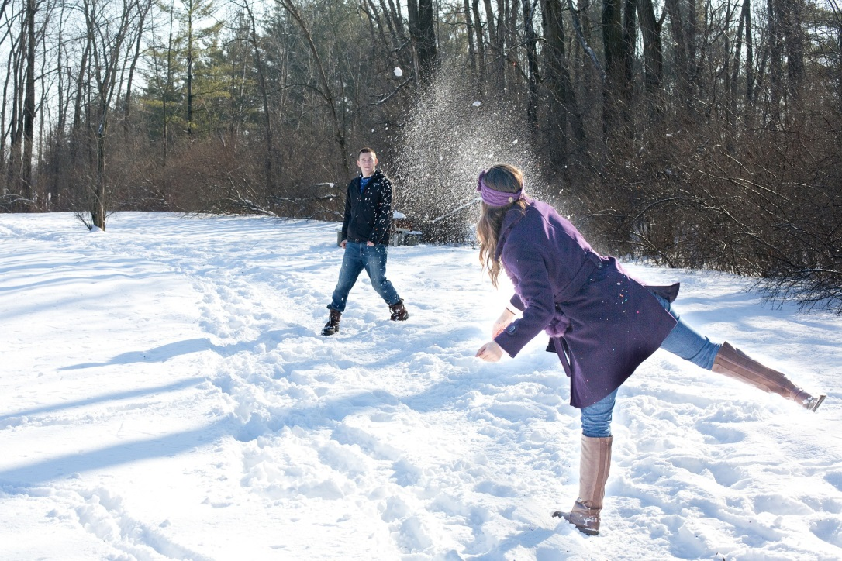
It’s the holidays!
What are you doing here?
Go and have some festive fun!

