Slide 1
The Indonesia earthquake
September 2018
Learning objective:
to explain what caused the Indonesia earthquake
to understand the effects and responses to the earthquake.

Slide 2
Starter:
What do you already know about earthquakes?
Draw a quick spider diagram / write a list of all the things you already know about earthquakes.
Ideas to get you started
How they’re caused?
Where do they occur?
What happens?
Be ready to share your answers with the class!

Slide 3
The Indonesia earthquake
September 2018
An earthquake struck Sulawesi in Indonesia on 28th September 2018.
It was a 7.4 magnitude earthquake.
Its epicentre was in the mountainous Donggala Regency, Central Sulawesi.
A tsunami occurred afterwards which struck Palu. The tsunami was 4-7m in height.
The effects of the earthquake and tsunami led to the deaths of over 2000 people.
Watch this video clip to see what happened. youtu.be/s2Oi4fXxoow

Slide 4
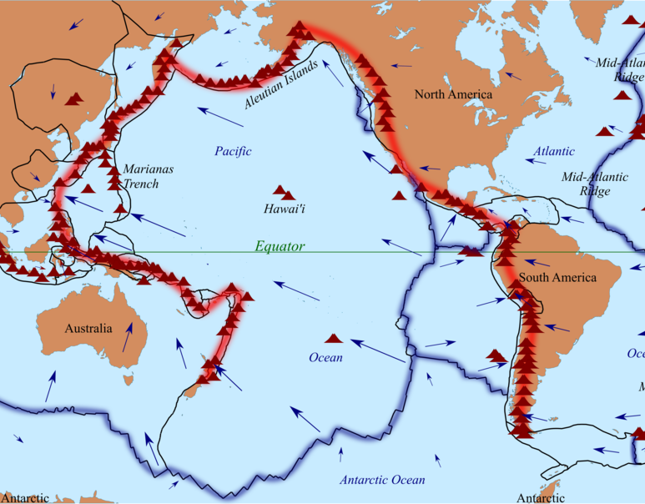
How did the earthquake in Indonesia occur?
Look at this map, what reasons can you give for the earthquake in Indonesia?
Eurasian plate
North American plate
‘Ring of fire’
Pacific plate
Cocos plate
South American plate
Indo-Australian plate
Nazca plate
Antarctic plate
Notes:
© By Astroskiandhike - This file was derived from: Tectonic plates boundaries detailed-en.svg by Sting, CC BY-SA 4.0, commons.wikimedia.org/w/index.php?curid=70859596

Slide 5
How did the earthquake in Indonesia occur?
The Indonesian islands are part of the Ring of Fire. The Ring of Fire is an arc of fault lines and volcanoes that stretches around the Pacific Ocean.
This area is 25 000 miles and is where the majority of earthquakes occur on Earth.
There were many earthquakes in Indonesia in 2018.
Sulawesi is located between the Australian, Pacific, Philippine and Sunda Plates leading to a greater chance of an earthquake.

Slide 6
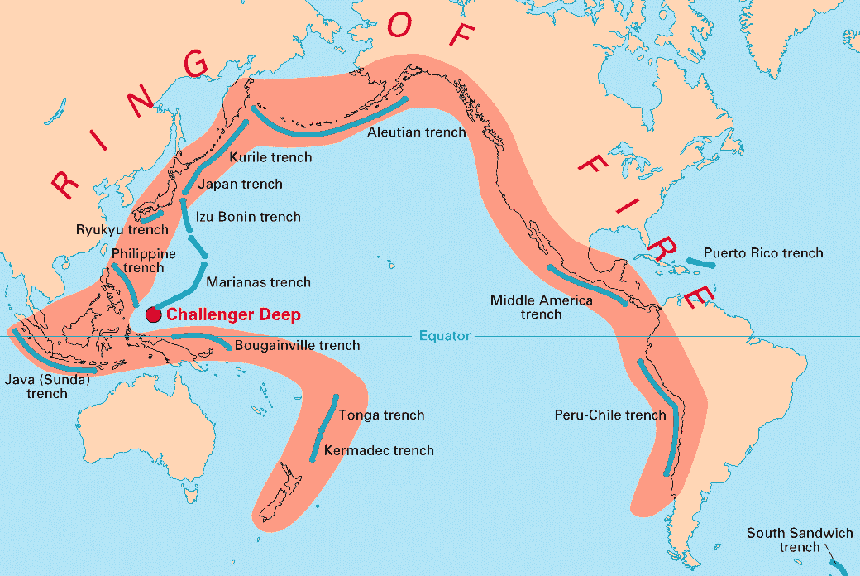
Describe the location of Indonesia.
Explain what the Ring of Fire is.
Explain why the Indonesian islands have a large number of earthquakes.
Task

Slide 7
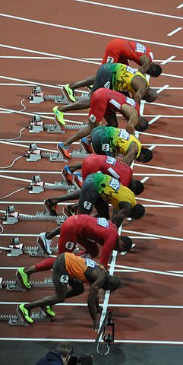
Challenge: information race!
On your worksheet there are 20 questions that need to be answered.
At the front of the room is the information that you need.
Only one person from each table can get up at a time. Your sheet and pen/pencil must remain at your table. You cannot shout across the room to your team mates.
You must work together to answer as many questions as you can in 5 minutes.
Are you ready?
Notes:
© By Darren Wilkinson - On your marks, Uploaded by Kafuffle, CC BY-SA 2.0, commons.wikimedia.org/w/index.php?curid=20750609

Slide 8
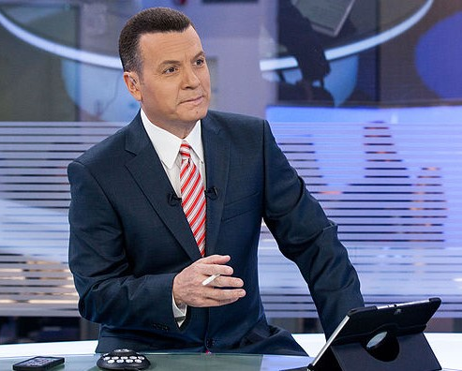
Task: TV report
Using the information you have gathered you are going to create a TV report on the earthquake and tsunami.
On your tables you will need at least two studio reporters, one outside reporter live from Indonesia and one local person who has survived the disaster.
You must explain what happened in Indonesia and what the impacts have been. You must also discuss the response to the disaster.
Remember that TV reports use factual information! Use facts and figures in your TV report rather than generic information.
Notes:
© By Michael Plutchok - Own work, CC BY-SA 3.0, commons.wikimedia.org/w/index.php?curid=45297137

Slide 9
Success criteria
Must include locations.
Must give information about why the earthquake
occurred.
Must discuss the impacts of the earthquake and
tsunami.
Must discuss the responses to the disaster.
Must include an interview with a survivor.
Must include facts and figures.
You will present your TV reports to the rest of the class. Make sure you are organised!

Slide 10
Plenary triangle
One
issue that made the impacts worse
Two
tectonic plates
Two
responses to the disaster
Three
social impacts
Three
economic impacts
Three
environmental impacts

