Slide 1
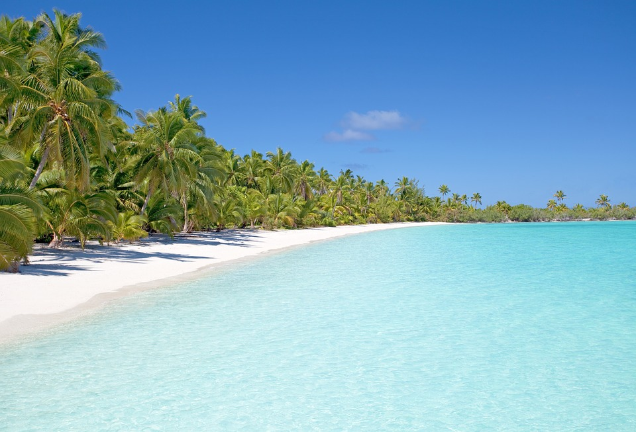
The island – Lesson 1
Inspired by this picture, write …
five adjectives
five verbs with adverbs
one simile
a sentence containing personification
one metaphor.

Slide 2
Imagine this …
20-30 children aged between seven and 13 find themselves stranded on an uninhabited and beautiful desert island. There are no adults!
In groups of three make notes on …
First impressions:
What would be the first things they would do?
What do they think they would enjoy about being on the island?
What positive experiences would there be?
What possible negative experiences could they imagine?

Slide 3
What about life on the island?
In your group of three, join with another group to make a group of six. Discuss the following questions:
Life on the island:
How would the students organise their life on the island?
What would be the practical problems they would have to solve?
What solutions can you think of to solve these problems?
Would they need to have a leader or leaders?
How would they decide on a leader?
Would there be any rules? If so, what rules would they have?

Slide 4
Remembering home
Remembering home:
How would being on the island be better than their lives at home?
How would being on the island be worse than their lives at home?
What would they miss the most?
Overall, would life be better or worse on the island compared to their lives in the UK now? Why?

Slide 5
The island – Lesson 2
Symbols for desert island life
Draw your own symbol to represent life on the desert island. You must explain your choice.
My symbol represents life on a desert island because …

Slide 6
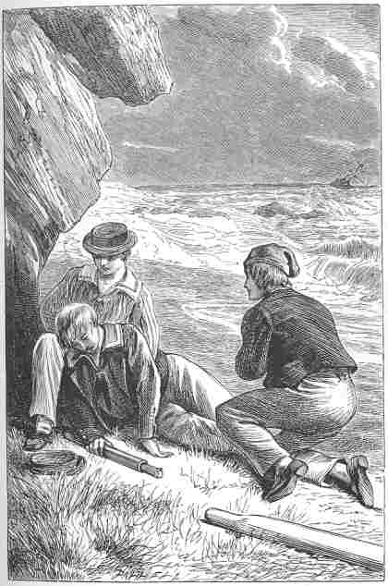
An island story
Working in groups of four:
Two of you read the extract (pausing briefly at the end of each paragraph).
One of you circles unfamiliar words.
One of you annotates with any questions.

Slide 7
Can you predict the four Ws?
Who is involved?
What will happen?
Why does it happen?
Where does it take place?

Slide 8
The Coral Island: A Tale of the Pacific Ocean
This story was written in 1858 by a man called J.M. Ballantyne.
The story is about three boys who are the only survivors of a shipwreck and are marooned on an island in the South Pacific.
The racist viewpoint, which modern readers find offensive, shows the 19th century imperialist context.

Slide 9
Romantic or realistic?
Rate the extract from one to five based on how realistic you think it is (1 = romantic 5 = realistic).
Find one or two bits of evidence that support your opinion. Copy them into your book. Evidence might include:
dialogue
character (actions, interactions, description, etc.)
vocabulary
setting.
Underneath, briefly explain how the evidence supports your view of the extract.
e.g. This supports my opinion that the extract gives a romantic/realistic view of life on a desert island because …

Slide 10
Further investigating of the text
The story has a happy ending and all the boys stay friends and support each other.
Does it remind you of any other stories or films?
Name them and explain why.

Slide 11
The island – Lesson 3
Descriptive writing planning
20-30 children aged between seven and 13 find themselves stranded on an uninhabited and beautiful desert island.
There are no adults!
Task: Chat to a partner about what you might include in a piece of descriptive writing based on the above situation.

Slide 12
Descriptive writing planning
Think about what you might include in your written piece. For example:
how and why do the children end up on the island?
what are the island’s physical features?
what character details would you include?
what problem/problems will the children encounter?
what practical things do they do in order to survive?
is there a dramatic event?
how will your writing end?

Slide 13
Descriptive writing planning
Create a paragraph plan
Suggested structure for your opening:
Paragraph 1 = describe the setting (just arrived).
Paragraph 2 = shift to another aspect of the setting.
Paragraph 3 = introduce another character (describe).
Paragraph 4 = movement/something happens (swim? explore?).

Slide 14
Descriptive writing - your island
Using your plan, write the opening section of your Coral Island style narrative when the children have just arrived on the island.
If you alter your plan while you are writing, you should show this alteration on your plan in a different colour pen.

Slide 15
Annotate with features of DROPS
Staring out longingly at the crystal cerulean waters, I had to pinch myself. A reminder that I was in paradise. Finally. No more tests. No more homework. No more rules. No more adults. Total bliss.
The golden sand tickled my skin as I clenched together my sweaty toes. The blazing orange sun kissed my back. There was a light breeze, and in front of me the frothy crests of the waves lapped onto the shore softly - lulling me into a day dream. Amazingly, I must have started to close my eyes as it wasn't long before my whole body began to rock in a wobbling motion and I nearly lost my balance. The screech of some exotic bird brought me back to the present.
Then, ‘No, you shut up! You’re the one to blame for all of this anyway!’
‘That’s unfair. If it wasn’t for your stupid sense of adventure then I bet all twenty of us would still be sat safely on that boat,’ Callum retorted.
No sooner had I started to forget about the worries of home, I was thrust into an argument with Callum and Ben. I sighed.
‘All right you two,’ I interrupted. ‘Leave it out.’

Slide 16
Annotate with features of DROPS
D
evices (similes, metaphors, personification, sensory language, alliteration, repetition, symbolism).
ange of punctuation (semi-colons, dashes, brackets, commas in a list, colons for impact).
peners (verbs, adverbs, prepositions, adjectives).
recise words (show, don’t tell, exact details, not too many adjectives).
hort sentence / short paragraph (one word, minor sentence, one sentence paragraph).
R
O
P
S

Slide 17
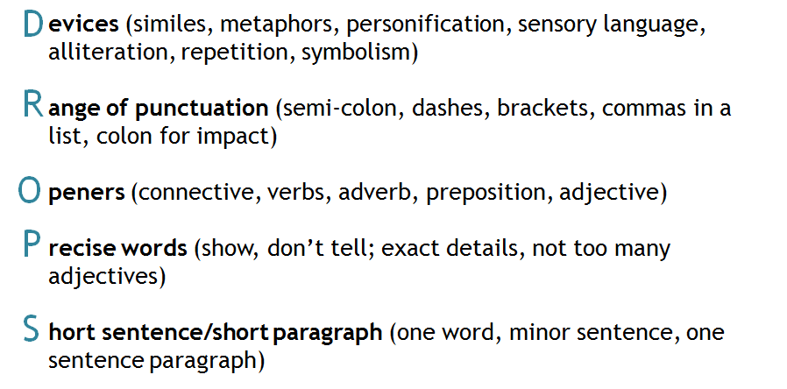
Find, highlight, add
Annotate your own work with features of DROPS.
What is your DROPS target?
Add to your work.

Slide 18
The island – Lesson 4
New vocabulary
Use a dictionary to find definitions for the following terms, then write the word and the definition in your own words into your book:
utopia
dystopia.

Slide 19
Utopian or dystopian?
You are going to begin an investigation:
Is your story utopian or dystopian?

Slide 20
Utopian or dystopian?
What features might you find in a utopian story?
What features might you find in a dystopian story?
Can you think of any books or films that fit into either of these categories?

Slide 21
Utopian or dystopian? Add these to your table.
Uses propaganda to control citizens.
Individuality and creativity banned.
Power is seen as corrupt.
Feeling of fear.
Leader is worshipped and has total control.
Encouraged to think independently.
Hides behind a mask of a perfect world.
Constant surveillance of its citizens.
Freedom of thought encouraged.
Citizens expected to obey.
No fear.
Everyone works together as a society.
Creativity encouraged.
Natural world embraced and industrialisation rejected.
All freedom is restricted.

Slide 22
Mini plenary
Summarise what a utopian and a dystopian story is using your own words.
Try to include as many of the features we have discussed as possible.
A utopian story is …
A dystopian story is …

Slide 23
The island - Lesson 5
Based on this image, do you think this text is utopian or dystopian?

Slide 24
1984 by George Orwell
Let’s look at quotations from the novel 1984 and decide whether we think it’s a utopian or a dystopian novel.

Slide 25
Independent task
Your group will be given a quotation from 1984 to study.
Read the quotations carefully and:
Highlight and annotate any evidence of a dystopian fiction (use table of features from previous lesson).
Highlight and annotate the tone/feeling conveyed e.g. fear/uneasiness etc.
Highlight and annotate anything else that the writer has done which you think is interesting.

Slide 26
Group 1
‘It was no use trying the lift. Even at the best of times it was seldom working, and at present the electric current was cut off during daylight hours. It was part of the economy drive in preparation for Hate Week.’
Read the quotation carefully and:
Highlight and annotate any evidence of a dystopian fiction (use table of features from previous lesson).
Highlight and annotate the tone/feeling conveyed e.g. fear/uneasiness etc.
Highlight and annotate anything else that the writer has done which you think is interesting.

Slide 27
Group 2
‘On each landing, opposite the lift shaft, the poster with the enormous face gazed from the wall. It was one of those pictures which are so contrived that the eyes follow you about when you move. BIG BROTHER IS WATCHING YOU, the caption beneath it ran.’
Read the quotation carefully and:
Highlight and annotate any evidence of a dystopian fiction (use table of features from previous lesson).
Highlight and annotate the tone/feeling conveyed e.g. fear/uneasiness etc.
Highlight and annotate anything else that the writer has done which you think is interesting.

Slide 28
Group 3
‘The instrument (the telescreen, it was called) could be dimmed, but there was no way of shutting it off completely. He moved over to the window: a smallish, frail figure, the meagreness of his body merely emphasized by the blue overalls which were the uniform of the Party.’
Read the quotation carefully and:
Highlight and annotate any evidence of a dystopian fiction (use table of features from previous lesson).
Highlight and annotate the tone/feeling conveyed e.g. fear/uneasiness etc.
Highlight and annotate anything else that the writer has done which you think is interesting.

Slide 29
Group 4
‘In the far distance a helicopter skimmed down between the roofs, hovered for an instant like a bluebottle, and darted away again with a curving flight. It was the police patrol, snooping into people’s windows. The patrols did not matter, however. Only the Thought Police mattered.’
Read the quotation carefully and:
Highlight and annotate any evidence of a dystopian fiction (use table of features from previous lesson).
Highlight and annotate the tone/feeling conveyed e.g. fear/uneasiness etc.
Highlight and annotate anything else that the writer has done which you think is interesting.

Slide 30
Film trailer for 1984
youtu.be/Z4rBDUJTnNU

Slide 31
The island – Lesson 6
Think back to your island …
Look again at your piece of writing. Is your work utopian or dystopian fiction?
Why might it seem utopian/dystopian?
How quickly might an island descend into dystopia?
Why?
How?

Slide 32
Changing the tone
Without rewriting the whole piece, plan how you could alter the tone of your writing to make it dystopian rather than utopian (or the other way round).
Remember to use the knowledge you have gathered from the texts we have looked at.
Redraft your writing
Use your plan to redraft your piece of writing.
Remember: you are not rewriting, you are redrafting, altering, manipulating and reforming the mood of your piece so that it becomes dystopian.

Slide 33
Analyse your work
Annotate your writing to show where you have made changes.
Analyse a partner’s writing to answer the following question:
Remember to:
Look at words and phrases that show the writing is dystopian.
Use references to support your answer.
How does the writer use language to create a dystopian or utopian story opening?

