Slide 1
Piecing the puzzle together; risk and resilience, Adverse Childhood Experiences (ACEs), children and young people’s mental health….
Maddie Burton
Senior Lecturer Child and Adolescent Mental Health, University of Worcester
m.burton@worc.ac.uk

Slide 2

Mental illness in children and young people
Prevalence

Slide 3
CAMH
The National Service Framework Children, Young People and Maternity Services (DH 2004) identified that 10% of 5-15 year olds had a diagnosable mental health disorder.
A further 15% have less severe problems and remain at an increased risk of future mental health problems.
‘Future in Mind’ (DH 2015) acknowledged one in 10 children need support for mental health problems.

Slide 4
NHS Digital prevalence (2018)
NHS Digital (2018) announced that one in eight (12.8%) of children and young people aged between five and 19, surveyed in England in 2017, had a mental disorder. This is an increase from one in ten (10%) in the last published research in 2004
Available from: NHS Digital (2018) https://digital.nhs.uk/news-and-events/latest-news/one-in-eight-of-five-to-19-year-olds-had-a-mental-disorder-in-2017-major-new-survey-finds (accessed April 2021)

Slide 5
NHS Digital prevalence (2020)
Estimates since the first Covid 19 lockdown are now 1 in 6 (16.0%)
Noted that (62.6%) children aged 5 to 16 years with a probable mental disorder had regular support from their school or college
Available from: https://digital.nhs.uk/data-and-information/publications/statistical/mental-health-of-children-and-young-people-in-england/2020-wave-1-follow-up (accessed April 2021)

Slide 6
In an average class of 30 15-year-old pupils:
Three could have a mental disorder
Ten are likely to have witnessed their parents separate
One could have experienced the death of a parent
Seven are likely to have been bullied
Six may be self-harming (Public Health England 2015)
(with the 2018 update and Covid 19/lockdown/school closures impact these figures will have increased)

Slide 7
Significant numbers of children have either none or very limited access to CAMHS
In turn increases pressure on universal and primary care services in both health and education settings left having to ‘hold’ cases

Slide 8
Reminder:
Half of lifetime MH problems
(except dementia) begin to emerge
by age 14 and three quarters by the mid-20s (DH 2011)
Unique position to undertake preventative work and MH promotion, stigma reduction,
and ‘normalise’ discussion
around ‘emotions’
Outside ‘home’, early years settings, schools and colleges are the places where children and young people spend most of their time with access to professionals
Schools offer a ‘window of opportunity’
In terms of support but also in signposting and accessing specialist assessment and interventions

Slide 9
Children and young people’s mental health
Understanding… The 4 Ps model,
Nature v nurture?

Slide 10
In children and young people, mental health is more specifically indicated by:
a capacity to enter into and
sustain mutually satisfying
personal relationships
continuing progression of
psychological development
ability to play and learn so attainments are appropriate for age and intellectual level
a developing moral sense of right/wrong
the degree of psychological distress and maladaptive behaviour within normal limits for child’s age and context.

Slide 11
Mental illness is considered and understood in four main areas:
Emotional disorders
Conduct and Neurodevelopmental disorders
Eating disorders
Early onset Psychosis

Slide 12
Mental ‘ill health’
An interpretation of illness and medicalisation of behaviours considered
to be beyond the ‘norm’ or ‘atypical’
But.... Often presented with a set of behaviours which could be seen as
acting out of the individual internal working model
Acting out is about ‘getting the hurt addressed’. ‘Avoiding anxiety’ can be
interpreted through Freud’s defence mechanisms https://www.youtube.com/ watch?v=ykIIRkmvRwM (3.45 mins) (accessed April 2021)
So....behaviours can/could be understood from a psychological perspective rather than a tendency to interpret illness
But we remain quite attached to a medical model especially in Adult Mental Health, less so in CAMHS

Slide 13
So what about child mental health and how can it emerge?
Combination of factors including sociological, psychological,
and biological
Can also be referred to as the 4 Ps
Introduced by Meyer in 1948 as the psychobiological approach
Further developed by Engel in 1980 as the biopsychosocial model

Slide 14
What is the 4Ps Model?
It is a model for understanding WHY someone has developed a MH problem and what may be preventing them from recovering. It looks at the factors which:
Predisposed someone to the MH problem
Precipitated the MH problem
Protected them from the MH problem (or could help them recover from it) or
Perpetuated the MH problem

Slide 15
There is an excellent MindEd tutorial about the 4Ps, called ‘Putting Information Together’:
https://www.minded.org.uk/Component/Details/447157 (accessed April 2021)
Have a go – it takes 20 – 30 minutes

Slide 16
Nature vs nurture?
Nature | ? | Nurture
What is inside us How we are made What we are born with Our genes Our talents Our disabilities Our physical health Our gender Our temperament Facts about US OUR BIOLOGY

Slide 17
Nature vs nurture?
Nature | ? | Nurture
 |  | What is outside us Factors in our surroundings (our environment) that affect us now or might have affected our development Difficulties and benefits caused by where, how, and with whom we live The impact of the society and culture we live in OUR SOCIAL SETTING

Slide 18
Nature vs nurture?
Nature | ? | Nurture
What is inside us. How we are made What we are born with Our genes Our talents Our disabilities Our physical health Our gender Our temperament Facts about US OUR BIOLOGY | ? | What is outside us Factors in our surroundings (our environment) that affect us now or might have affected our development.Difficulties and benefits caused by where, how, and with whom we live The impact of the society and culture we live in OUR SOCIAL SETTING

Slide 19
Nature vs nurture?
Nature | ? | Nurture
What is inside us. How we are made What we are born with Our genes Our talents Our disabilities Our physical health Our gender Our temperament Facts about US OUR BIOLOGY | Our development, our thinking (cognition), our learning and behaviour. This, in turn, affects how we interpret, understand and interact with people and the world. OUR PSYCHOLOGICAL make-up. | What is outside us. Factors in our surroundings (our environment) that affect us now or might have affected our development Difficulties and benefits caused by where, how, and with whom we live The impact of the society and culture we live in OUR SOCIAL SETTING.

Slide 20
Have a look at what we need to be doing:
‘Talking Mental Health’:
from Anna Freud Centre for Children and Families
https://www.youtube.com/watch?v=nCrjevx3-Js (5.27)
And ‘We all have Mental Health’: https://www.youtube.com/watch?v=754__xBsak4 (5.39)
(accessed April 2021)

Slide 21
Adverse childhood experiences and risk and resilience

Slide 22
The 10 ACEs in the 1990’s Kaiser study (17,000 participants):
Five are personal:
Physical abuse, verbal abuse, sexual abuse, physical neglect, and emotional neglect.
Five are related to other family members:
A parent who’s an alcoholic, a mother who’s a victim of domestic violence, a family member in jail, a family member diagnosed with a mental illness, and the disappearance of a parent through divorce, death or abandonment.
Today we could consider many other traumas such as bullying, racism, homelessness, surviving an accident or disaster, to name a few. At the time of the study these were the traumas identified as common to them.

Slide 23
The study found a strong link between trauma and chronic disease in adulthood as well as social and emotional problems as shown in the Resilience film trailer: https://www.filmsforaction.org/watch/resilience-the-biology-of-stress-and-the-science-of-hope/ (2.10 mins)
Nadine Burke Harris TED talk (16.02 mins) How childhood trauma affects health across a lifetime, available from:
https://www.ted.com/talks/nadine_burke_harris_how_childhood_trauma_affects_health_across_a_lifetime
You can work out your own ACE score here: https://www.ncjfcj.org/sites/default/files/Finding%20Your%20ACE%20Score.pdf
Young Minds have an excellent resource you can download; Addressing Adversity: https://youngminds.org.uk/resources/policy/addressing-adversity-book/
(all accessed April 2021)

Slide 24
There are links between Adverse Childhood Experiences (ACEs) and
child and adolescent mental health
Yet despite experiencing ACEs, not all children will have a poor outcome
But children experiencing 4 or more ACEs are 4 times more likely to have low levels of mental wellbeing
We can also consider this in the context of ‘risk and resilience’
It is essential we understand ‘at risk’ groups and the importance of ‘resilience’ and its role in mitigating risk
There is now an increased dialogue on trauma and the effect of trauma on development with life long consequences
Move to areas and schools being ‘trauma informed’, see: https://traumainformedschools.co.uk/ (accessed April 2021)

Slide 25
Helpful for those working in universal settings with children and young people with an interest in attachment and child and adolescent mental health to be
able to interpret what is being communicated through children's behaviour in the setting or classroom and know how to help
Important to understand ‘behaviour’ what is driving/being communicated by ‘behaviour’ and what is the context?
Hearing the story
Think ‘systemically’; what do we mean?
About being curious

Slide 26
Requires resources, investment and understanding
Being ‘trauma informed’ helps
Psychological distress is not necessarily indicative of a mental health problem – this is a very important consideration
Could be a ‘normal reaction’ to overwhelming stressors and trauma fuelling anxiety; reminder these
are extrinsic factors and nurture
trumps nature…
Having a supportive relationship with
an identified person is key
There is often an urge for diagnosis
There is a need for recognition and appropriate help
Re-programming of language can be helpful
Not: What’s wrong with you? Instead: What has happened to you?

Slide 27
Mental health, ACEs and Risk and Resilience theory
Piecing the puzzle together

Slide 28
ACEs and Risk and Resilience theory
‘Risk’ means risk factors that can predispose a child or young person to mental health problems
These are similar to ACEs and include features that sit in the domains of the family, the environment and the child themselves
The model was identified by Pearce in 1993 and was included in the commissioning document Together we Stand that set up the CAMHS tiered service in 1995

Slide 29
Risk and resilience model
Pearce (1993) defined a number of factors within three main areas of risk:
environmental/contextual
the family and
the young person/child

Slide 30
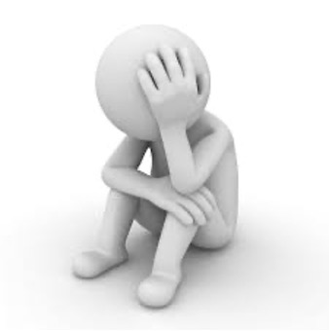
Environment/context
Socio-economic disadvantage
Homelessness
Disaster
Discrimination
Violence in the community
Being a refugee/asylum seeker
Other significant life event

Slide 31
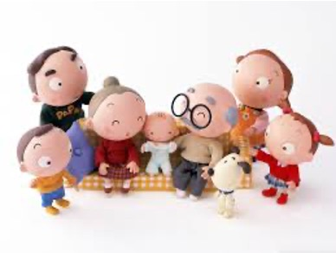
Family
Early attachment/nurturing problems
Parental conflict
Family breakdown
Inconsistent/unclear discipline
Hostile and/or rejecting relationships
Significant adults failure to adapt to child’s changing developmental needs
Physical, emotional, sexual abuse
Parental mental and/or physical illness
Parental criminal behaviour
Death/loss, bereavement issues relating to family members/friends

Slide 32
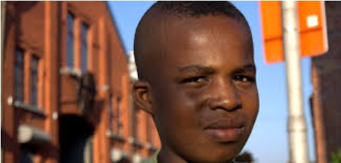
Child/Young person
Genetic influences
Low IQ/learning difficulties
Specific developmental delay
Communication difficulties
Difficult temperament
Gender identity conflict
Chronic physical illness
Neurological disorder
Academic failure/poor school attendance
Low self esteem

Slide 33
But what about resilience? These factors can mitigate risk:
Secure attachments
Self-esteem
Social skills
Familial compassion and warmth
A stable family environment
Social support systems that encourage personal development and coping skills
A skill or talent
In Brief – What is Resilience (2:22 mins) (accessed April 2021) https://www.youtube.com/embed/cqO7YoMsccU

Slide 34
Useful resilience exercise to do:
http://developingchild.harvard.edu/resilience-game/ (0.55 mins intro, accessed April 2021)

Slide 35
Important to understand the role of risk and resilience so there can be an active response
It can be helpful if schools take account of the stress children are under and display understanding and concern
Unfortunately, trauma and stress can get played out and are then seen as a behavioural
problem so often these children are misunderstood
A sense of ‘connectedness’ with school acts as a protective factor for mental health
Supportive interventions can act as a turning point
In Brief – How resilience is built (2:18 mins, accessed April 2021) https://www.youtube.com/embed/xSf7pRpOgu8

Slide 36
Despite major adversity, many young people and children cope well despite overwhelming odds
Perhaps understandably, others will find this more difficult and prolonged (Young Minds 2016)
The key is resilience which acts as a protective factor. Rutter (1985) and again later in (2006) described this as a
dynamic evolving process across the life span and is not just about static factors
The model of risk and resilience is not based on risk and protective factors in themselves but rather on how they interact
In Brief – The Science of Resilience (2:30 mins accessed April 2021) https://www.youtube.com/watch?v=1r8hj72bfGo

Slide 37
‘Resilience is the happy knack of being able
to bungy jump through the pitfalls of life.’
(Fuller, 1998, p. 75)
‘The capacity of a system to absorb disturbance, undergo change and still retain essentially the same function, structure, identity, and feedbacks.’
(The Resilience Alliance, 2011, para 9)

Slide 38
What are we already doing to build resilience?
Remember, Rutter defined resilience as:
‘Resilience seems to involve several related elements. Firstly, a sense of self-esteem and confidence (GROTBERG’S I AM); secondly a belief in one’s own self-efficacy (I AM) and ability to deal with change and adaptation (I CAN/I HAVE); and thirdly, a repertoire of social problem solving approaches (I CAN).’
Rutter (1985)

Slide 39
Grotberg’s model
Grotberg’s (1995) school-based programmes to enhance CYP’s resilience
These are based on the hypothesis that to overcome adversities, children draw from three interacting, dynamic sources of resilience:
I AM
I HAVE
I CAN

Slide 40
I AM – personality, self-esteem etc
I HAVE – social, familial and group supports, with safety, trust, good boundaries etc
I CAN – use support appropriately, attach, emotionally regulate, manage anger etc , (needs to be taught)
(see: A guide to promoting resilience in children; strengthening the human spirit, Grotberg, E, 1995 http://www.bibalex.org/Search4Dev/files/283337/115519.pdf
(accessed April 2021)

Slide 41
Resilience is a process of adaptation following stressful and/or traumatic events
Mental health problems are not proof of a lack of resilience; they can be a normal reaction to abnormal circumstances
Therapeutic responses; being ‘held in mind’, a sense of a ‘good object’ and an experience of being ‘container/contained’ (Wilfred Bion)
Resilience strategies include; choices, behaviour and resources used to promote resilience

Slide 42
‘The resilience of some children and young
people is remarkable.
In spite of very difficult life experiences, they do not necessarily have therapeutic needs, but all do need stability, love, warmth.’
(Bunting, p. 23, Young Minds, 2006)
And so do we who seek to help them

Slide 43
Current government plans:
Green paper (DH, DfE, 2017) Transforming Children and Young People’s Mental Health Provision and Government Response to the Consultation on Transforming Children and Young People’s Mental Health Provision: a green paper and Next Steps (DHSC, DfE 2018)

Slide 44
Three core proposals
Designated Senior Lead for mental health in all schools and colleges
Mental Health Support Teams
Four week waiting time for access to specialist CAMHS
See: https://schoolsweek.co.uk/first-school-mental-health-support-teams-will-be-set-to-work-by-the-end-of-2019/
(accessed April 2021)

Slide 45
But whilst this is welcome; a reminder:
CAMH represents under 1% of the total NHS budget
1 in 3 children/young people will
get specialist support
That leaves 2 out of 3 reliant on others or with no support
Majority of needs will be met
outside the NHS
Focus on schools for preventative work and mental health interventions
£1.4 billion to support the School Designated Lead and Mental Health Team but only 1 in 4 schools by 2022/3 (RSA 2018)
Left with having to be creative….
Community black hole the architecture is not there anymore
Need to be part of the challenge

Slide 46
Have we pieced the puzzle together and joined the dots?

Slide 47
Children and young people’s health requires attention, understanding including an appropriate response as urgently as any other health crisis
Needs to be understood within a
context of past and current experiences
The role of trauma and its effect on psychological well-being and outcomes
Let’s be ‘trauma informed’
Remember the ACEs
Take your own score
Lets reframe our language; not: What’s wrong with you? Instead: What has happened to you? Being curious…………
Work on improving resilience
We must consider our own self care and ensure access to supervision

Slide 48
The following slides contain useful resources you can access

Slide 49
Youth Mental Health and Schools; a briefing
Here is the link to a paper that followed a round table meeting in the House of Commons I attended in March 2018 and was subsequently presented to government in July 2018:
https://cfey.org/wp-content/uploads/2018/06/Schools-and-Youth-Mental-Health.-Menzies-et-al.-2018.pdf (accessed April 2021)

Slide 50
Education Support Partnership
Provides mental health and wellbeing support to all education staff and organisations
BACP registered counsellors
https://www.educationsupportpartnership.org.uk/ (accessed April 2021)

Slide 51
This is a must watch:
A Whole School Approach to Mental Health (RSA 2018)
Available from: https://www.youtube.com/watch?v=ORn-5AOvjLg (accessed April 2021)
And here is the link where you can also download a publication A Whole School Approach RSA Action and Research Centre Critchley et al (2018)
https://www.thersa.org/discover/publications-and-articles/reports/a-whole-school-approach-to-mental-health (accessed April 2021)

Slide 52
Key paper:
Promoting children and young people’s emotional health and wellbeing; A whole school and college approach (Public Health England 2015) available from: https://assets.publishing.service.gov.uk/government/uploads/system/uploads/attachment_data/file/958151/Promoting_children_and_young_people_s_emotional_health_and_wellbeing_a_whole_school_and_college_approach.pdf (accessed April 2021)

Slide 53
(DfE 2018) Supporting mental health in schools and colleges includes a range of excellent resources including practice examples:
https://www.gov.uk/government/publications/supporting-mental-health-in-schools-and-colleges (accessed April 2021)

Slide 54
What works in promoting social and emotional well-being and responding to mental health problems in schools?
Advice for Schools and Framework Document, Professor Katherine Weare, National Children’s Bureau, (2015) https://www.ncb.org.uk/sites/default/files/uploads/documents/Health_wellbeing_docs/ncb_framework_for_promoting_well-being_and_responding_to_mental_health_in_schools.pdf
And: https://webcontent.ssatuk.co.uk/wp-content/uploads/2016/06/02104816/Katherine-Weare-Keynote-Speaker.pdf (both accessed April 2021)

Slide 55
No Health Without Mental Health (DH 2011) (physical and mental health given equal importance for the first time)
A strong focus of early intervention and ‘starting well; ensuring everyone has the best start in life’.
Positive parenting is fundamental to good mental health and wellbeing and
to lifelong resilience to adversity.
Particularly important as half of lifetime mental health problems have developed before age 14.
Maternal mental health and the mental health of both parents is an important factor for the healthy development and safeguarding of children. Children whose mothers have poor mental health have a four to five fold increased risk of developing mental health problems.

Slide 56
Future in Mind Promoting, Protecting and improving our Children and Young People’s Mental Health and Wellbeing (DH 2015)

Slide 57
Future in Mind cont’d…
Shifts the focus onto preventative work with the plan that universal settings will include professionals and workers with CAMH knowledge
In order to offer supportive work and early help and signposting
Schools in a unique position given audience of children and young people now in education until 18
The professional group spending the most time with children

Slide 58

Minded
https://www.minded.org.uk/

Slide 59
Schools in Mind; Specialist support and innovation for school mental health development
Developed by the Anna Freud Centre to help school professionals in finding, evaluating and implementing solutions that promote the mental health and wellbeing of entire school communities.
The network provides an opportunity for school professionals to discuss and share materials on key school mental health issues with each other and with educational, mental health and academic experts.
https://www.annafreud.org/what-we-do/schools-in-mind/ (accessed April 2021)

Slide 60

Heads Together Mentally Healthy Schools
https://www.mentallyhealthyschools.org.uk/about/

Slide 61

Young Minds
https://www.youngminds.org.uk

Slide 62

Royal College of Psychiatrists
https://www.rcpsych.ac.uk/mental-health/parents-and-young-people

Slide 63
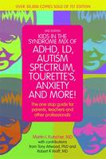
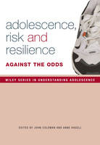
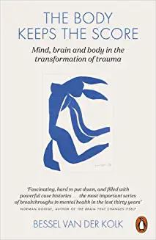
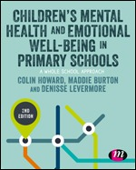
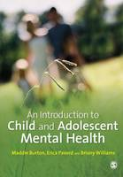
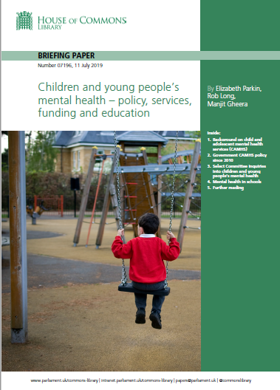
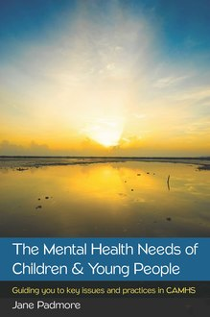
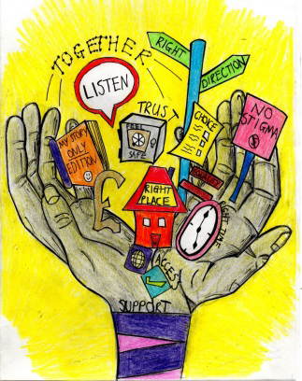
Future In Mind

Slide 64
Thank you

Slide 65


Slide 66
References
Bunting, M, (2006) Looking after looked after children, sharing emerging practice, Young Minds, London, available from: https://issuu.com/philayres/docs/lacmentalhealth (accessed April 2021)
Department of Health (2004) The Mental Health and Psychological Well-being of Children and Young People, CAMHS Standard, National Service Framework for Children, Young People and Maternity Services, available from: https://www.gov.uk/government/uploads/system/uploads/attachment_data/file/199959/National_Service_Framework_for_Children_Young_People_and_Maternity_Services_-_The_Mental_Health__and_Psychological_Well-being_of_Children_and_Young_People.pdf (Accessed April 2021).
Department of Health (2011) No Health Without Mental Health A cross-government mental health outcomes strategy for people of all ages, available from: https://www.gov.uk/government/uploads/system/uploads/attachment_data/file/213761/dh_124058.pdf (Accessed April 2021).
Department of Health (2015) Future in Mind Promoting, Protecting and improving our Children and Young People’s Mental Health and Wellbeing available from: https://assets.publishing.service.gov.uk/government/uploads/system/uploads/attachment_data/file/414024/Childrens_Mental_Health.pdf (Accessed April 2021)
Department of Health and Department for Education (2017) Transforming children and young people’s mental health provision; a green paper, available from: https://assets.publishing.service.gov.uk/government/uploads/system/uploads/attachment_data/file/664855/Transforming_children_and_young_people_s_mental_health_provision.pdf (accessed April 2021)

Slide 67
References cont’d
Department of Health and Social Care and Department for Education (2018) Government Response to the Consultation on Transforming Children and Young People’s Mental Health Provision: a Green Paper and Next Steps, available from: https://assets.publishing.service.gov.uk/government/uploads/system/uploads/attachment_data/file/728892/government-response-to-consultation-on-transforming-children-and-young-peoples-mental-health.pdf (accessed April 2021)
Engel GL (1980) The clinical application of the biopsychosocial model. American Journal of Psychiatry 137:535-544.
Fuller (1998), p. 75, available from: https://aifs.gov.au/cfca/publications/resilience-still-useful-concept-when-working-child/what-resilience (Accessed April 2021)
King, L, Rosa, G (2019) State of Children’s Rights in England 2018, Executive Summary, Children’s Rights Alliance England, available from: http://www.crae.org.uk/media/127101/B1_CRAE_EXEC-SUM_2018_WEB.pdf (accessed April 2021)
Meyer A (1948). The Commonsense Psychiatry of Dr Adolf Meyer. New York: McGraw-Hill
Pearce J, (1993) as cited in ‘Together we Stand’ The Commissioning, Role and Management of CAMHS, p. 23, (1995) HAS Report, London, HMSO.
RSA (2018) A whole school approach to mental health, available from: https://www.youtube.com/watch?v=ORn-5AOvjLg (accessed April 2021)
Rutter M, (2006) Implications of resilience concepts for scientific understanding, Annals of the New York Academy of Science, 1094: 1-12.
Rutter, M, (2012) Resilience as a dynamic concept, Development and Psychopathology, 24 (2012), 335-344, Cambridge University Press.
The Resilience Alliance (2011), available from: https://aifs.gov.au/cfca/publications/resilience-still-useful-concept-when-working-child/what-resilience (Accessed April 2021)
Young Minds (2016) Supporting your child’s Self-esteem, available from: https://youngminds.org.uk/find-help/for-parents/parents-guide-to-support-a-z/parents-guide-to-support-self-esteem/ (Accessed April 2021).

